Slide 1
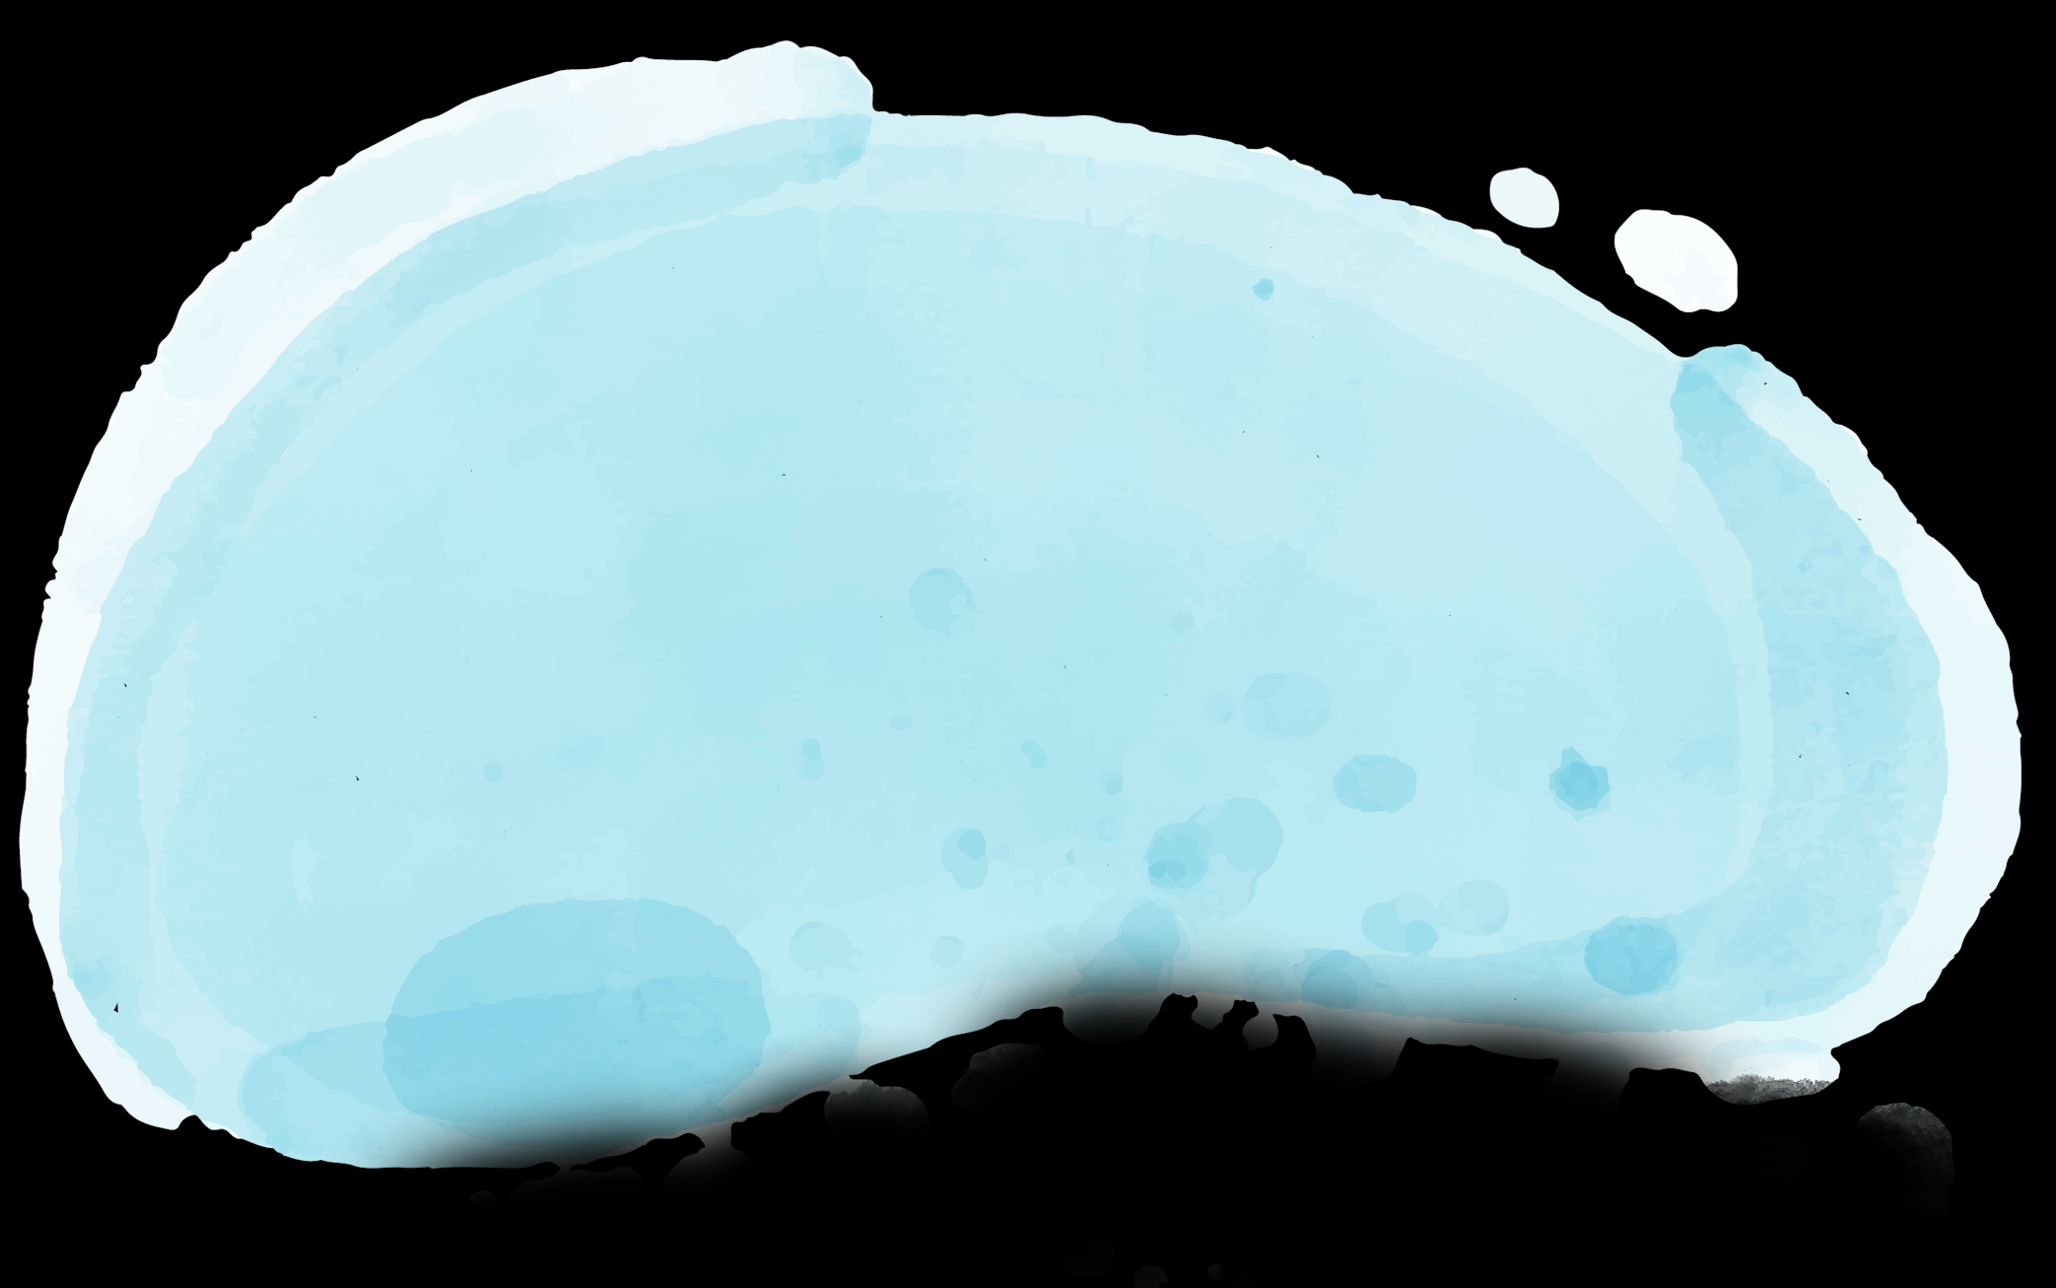
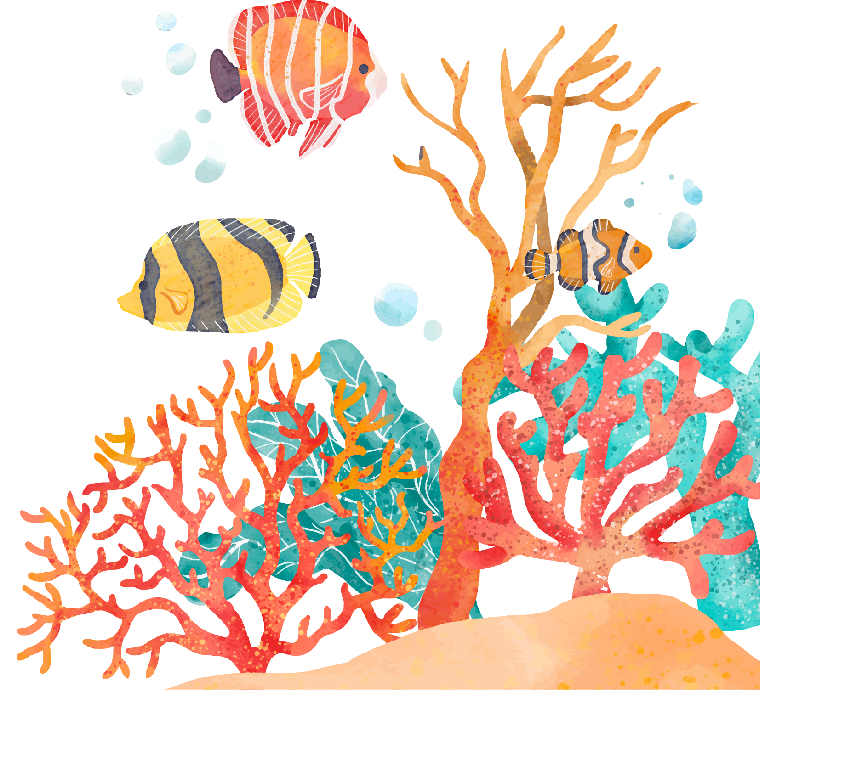
BIOLOGY LESSON
Here is where your presentation begins

Slide 2
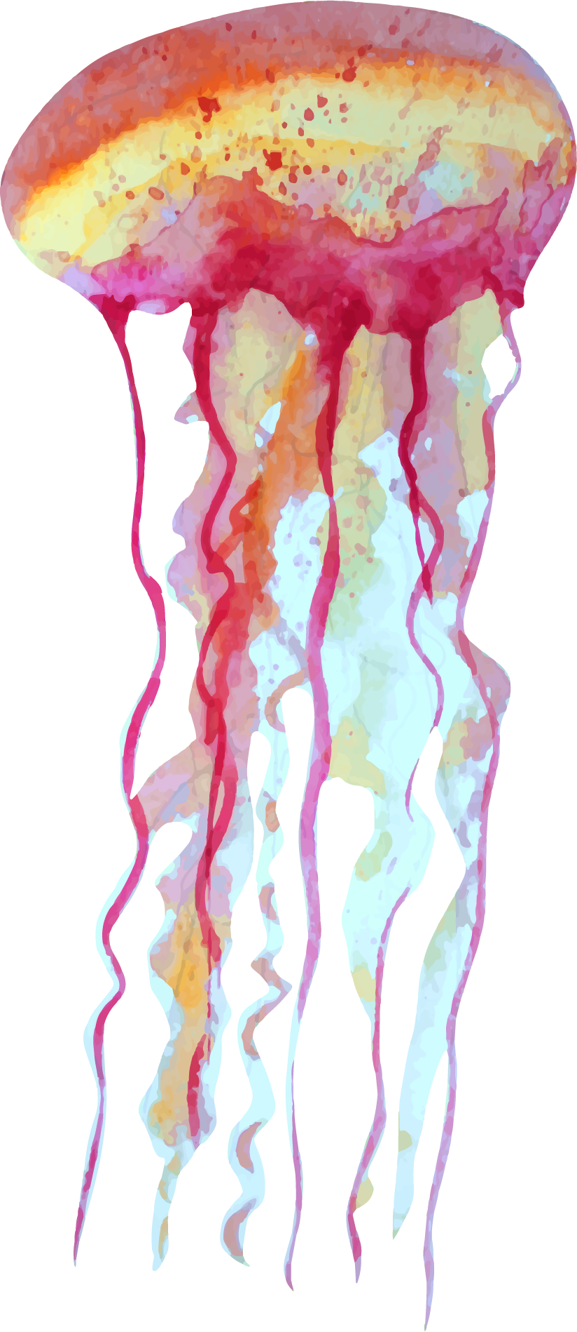
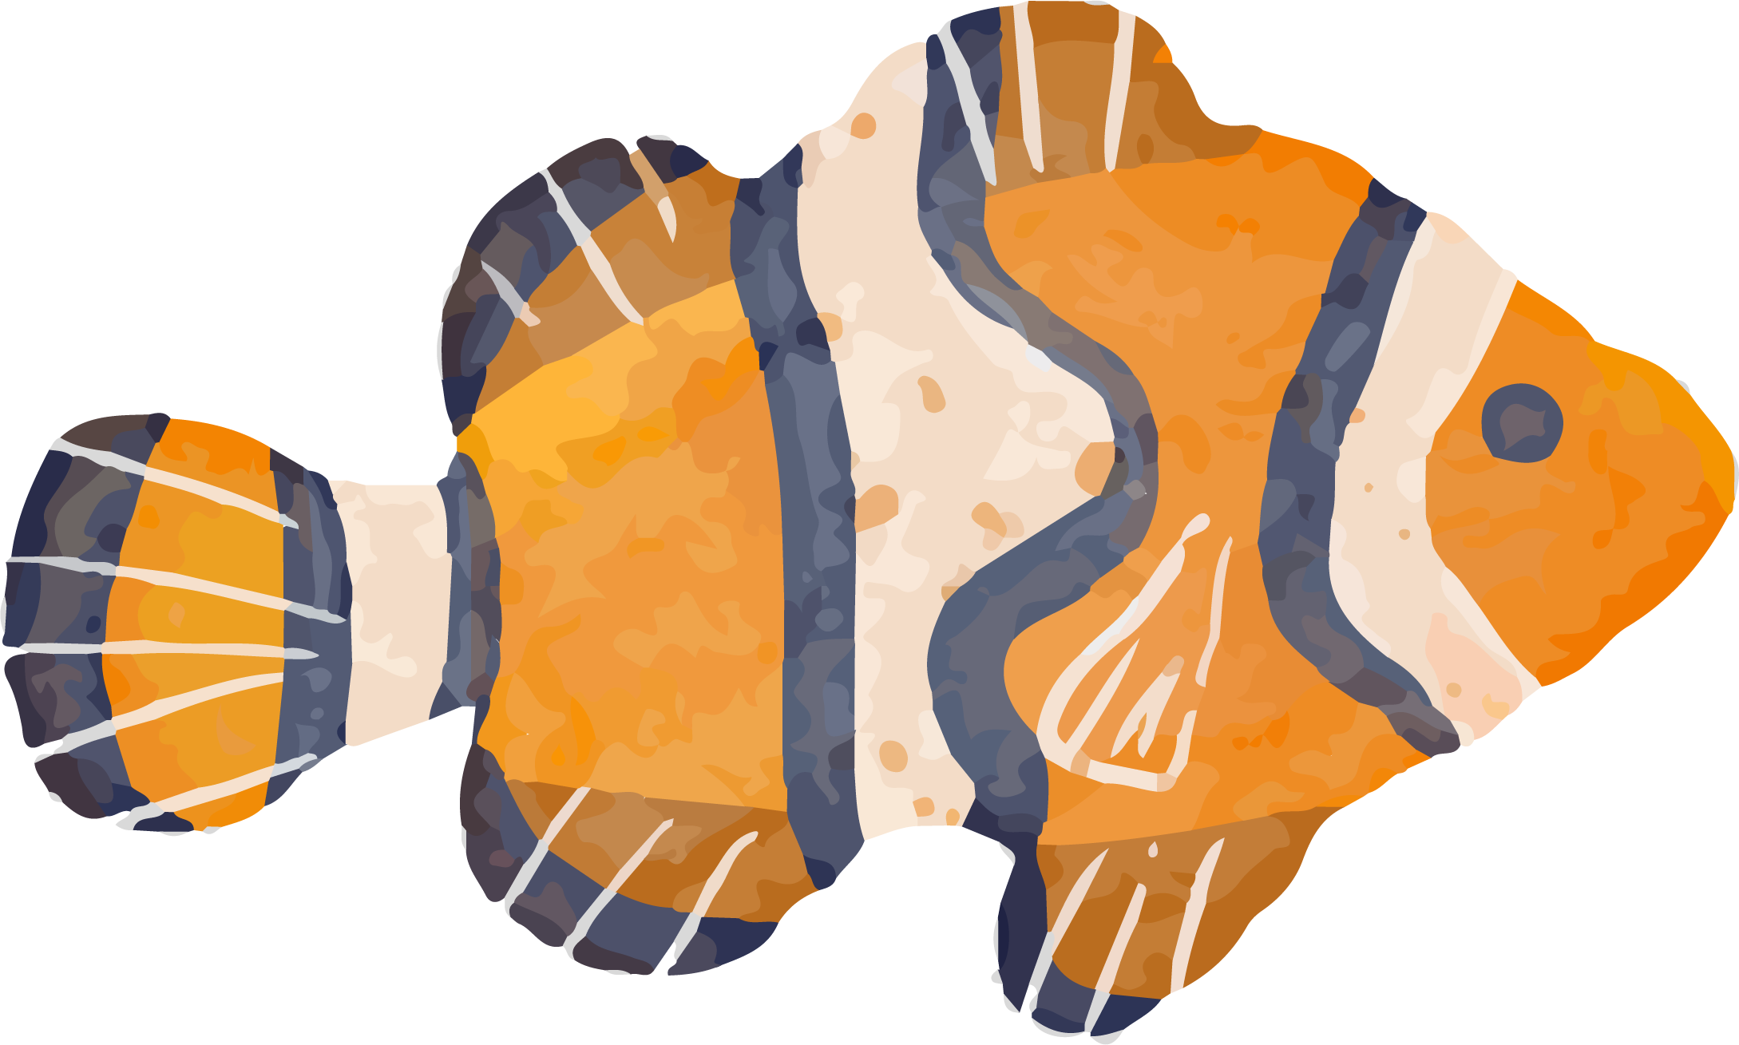
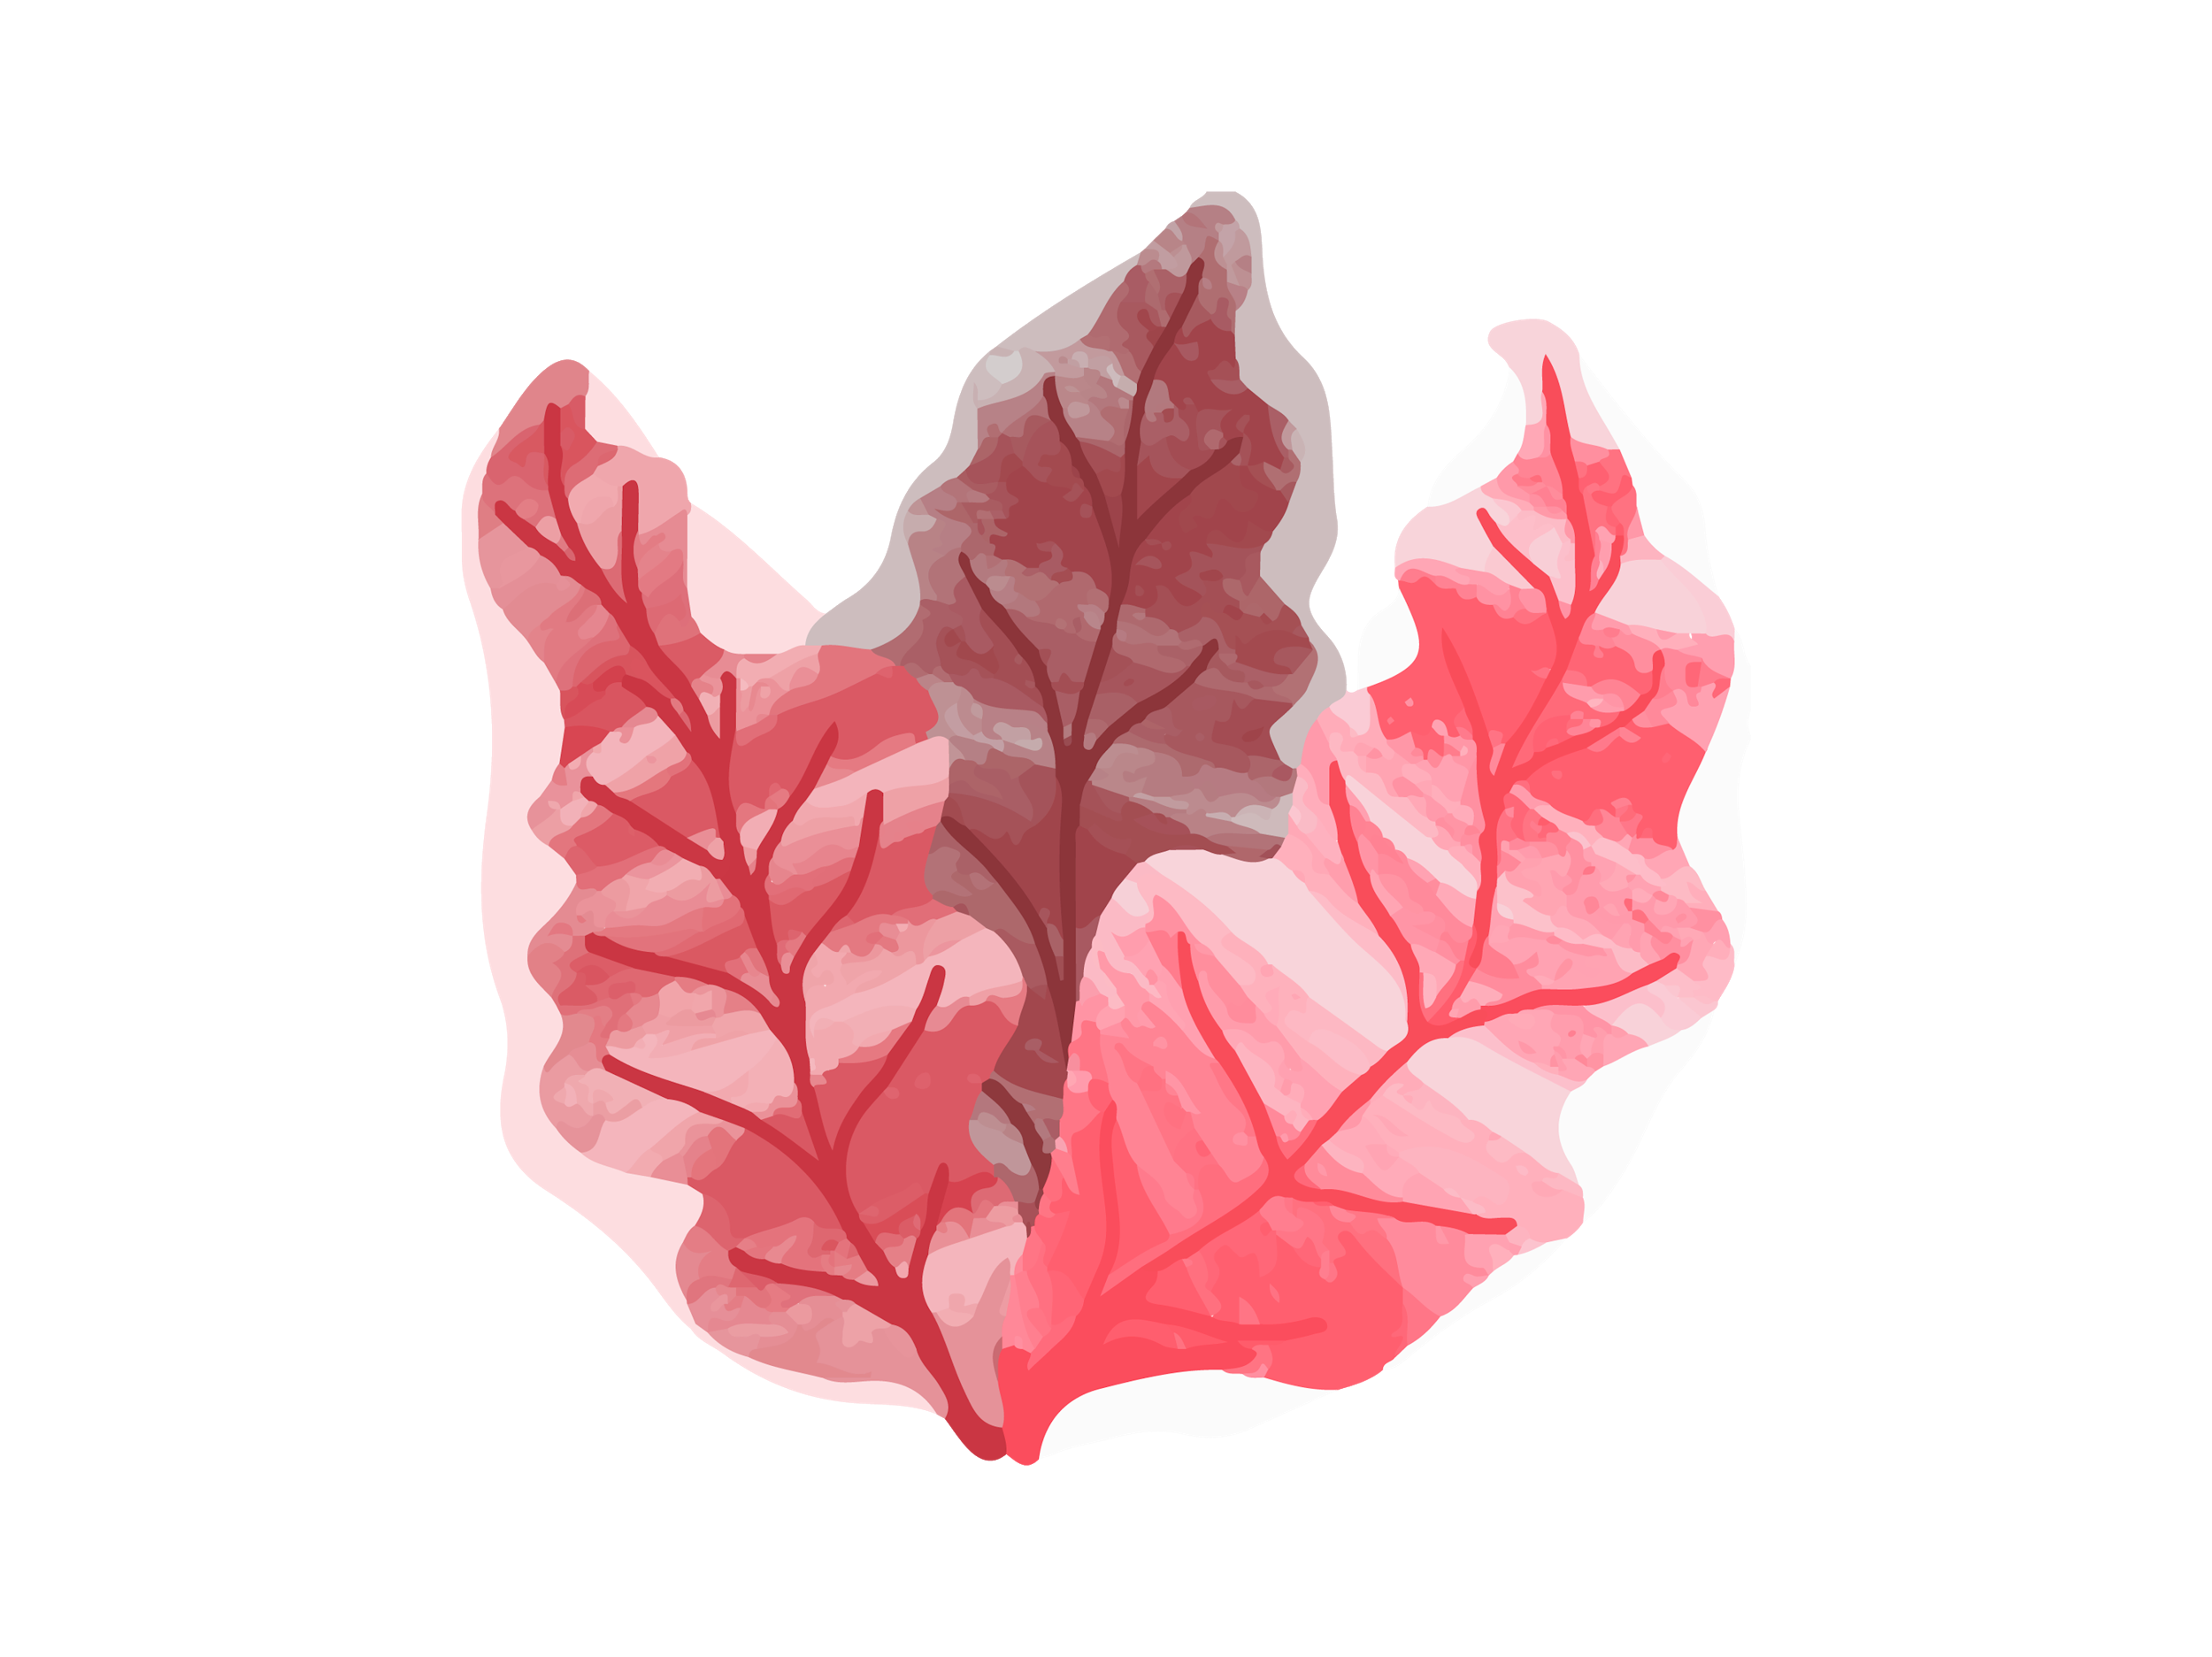
01
03
OVERVIEW
ASSIGNMENT
02
04
FEATURES OF THE TOPIC
ABOUT THE TOPIC

Slide 3
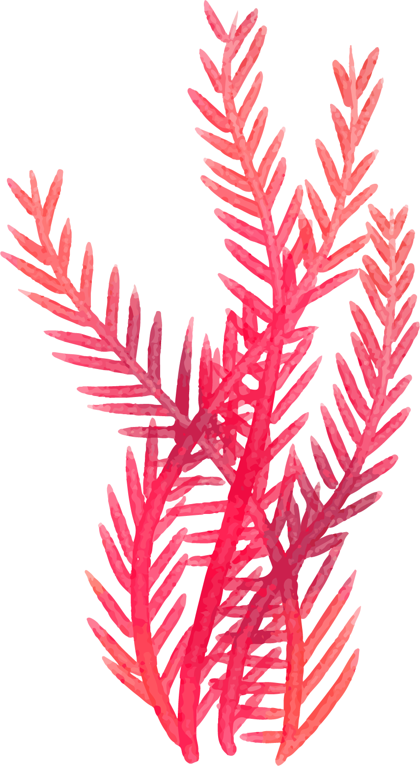
INTRODUCTION
Venus has a beautiful name and is the second planet from the Sun. It’s terribly hot—even hotter than Mercury—and its atmosphere is extremely poisonous. It’s the second-brightest natural object in the night sky after the Moon

Slide 4
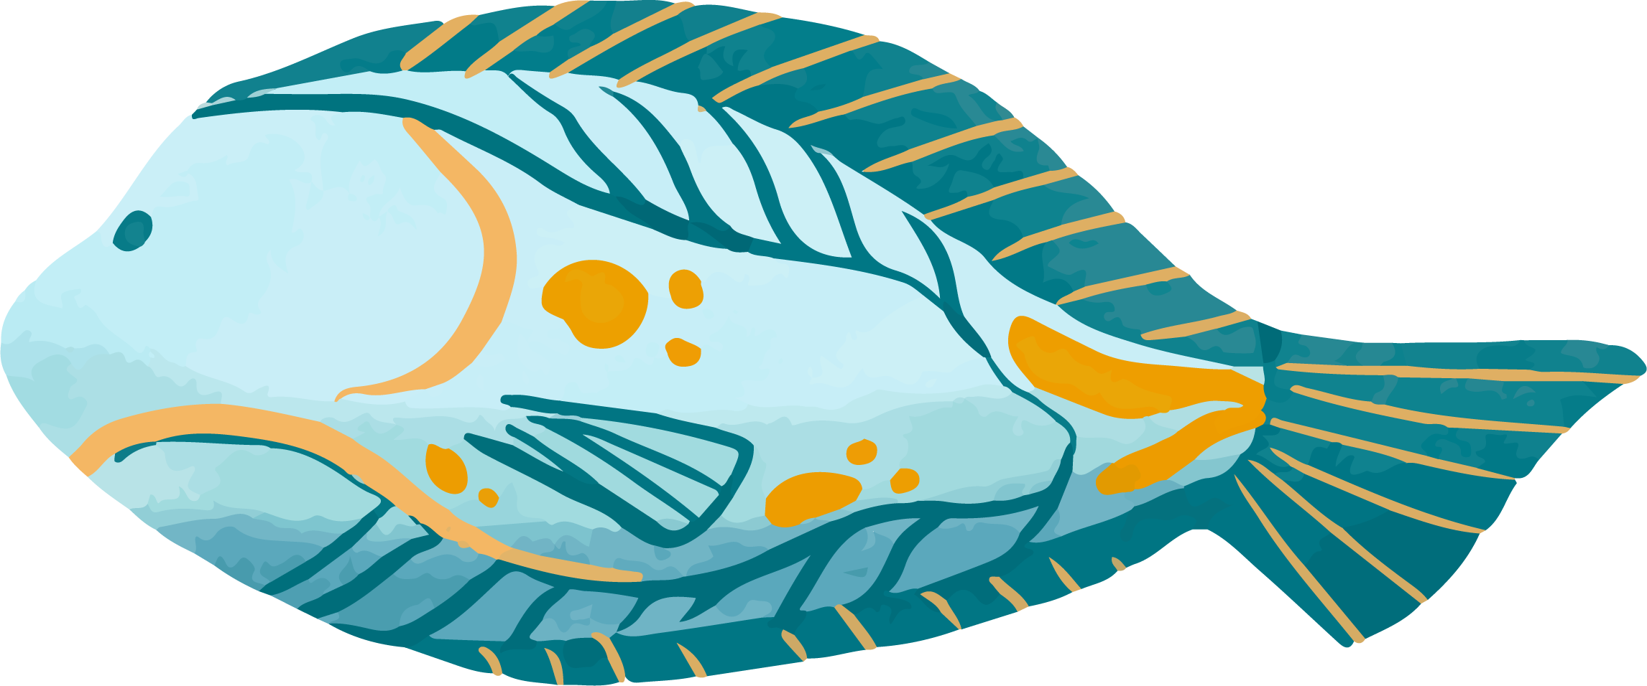
—SOMEONE FAMOUS
“This is a quote. Words full of wisdom that someone important said and can make the reader get inspired.”

Slide 5
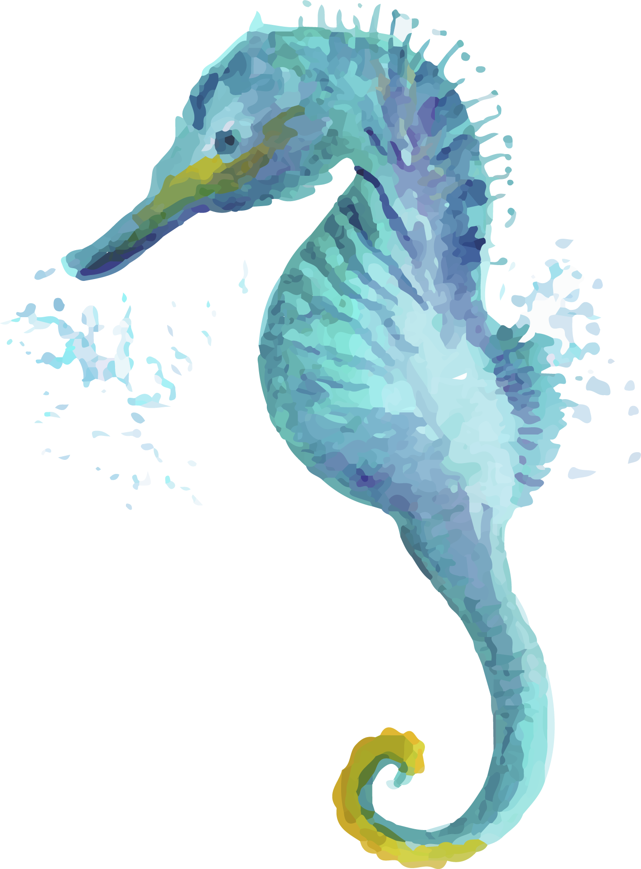
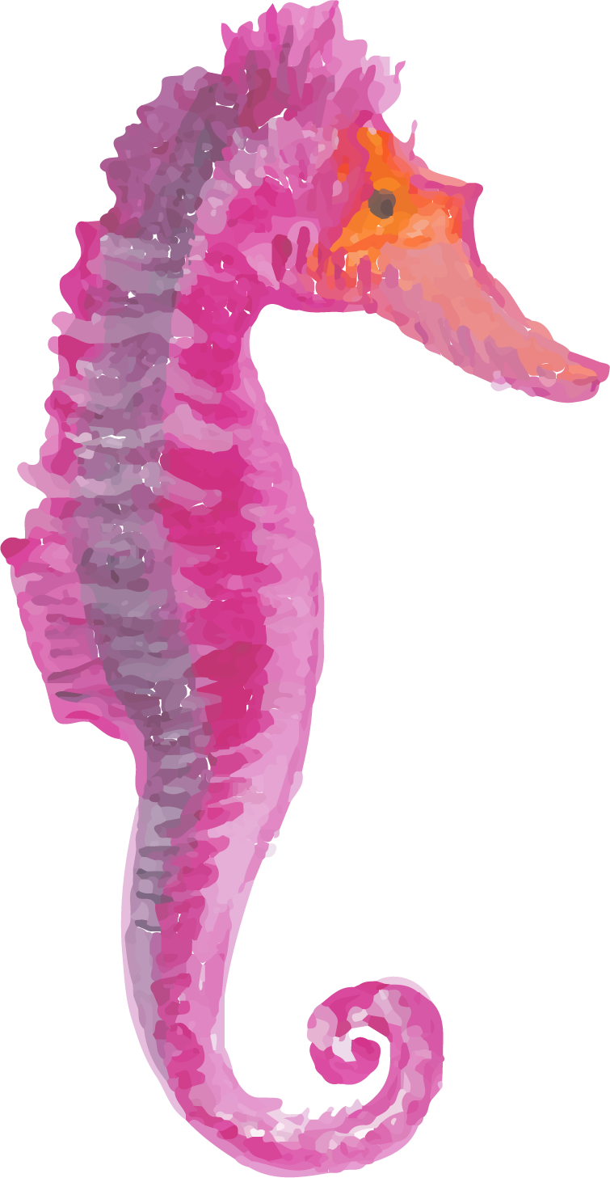
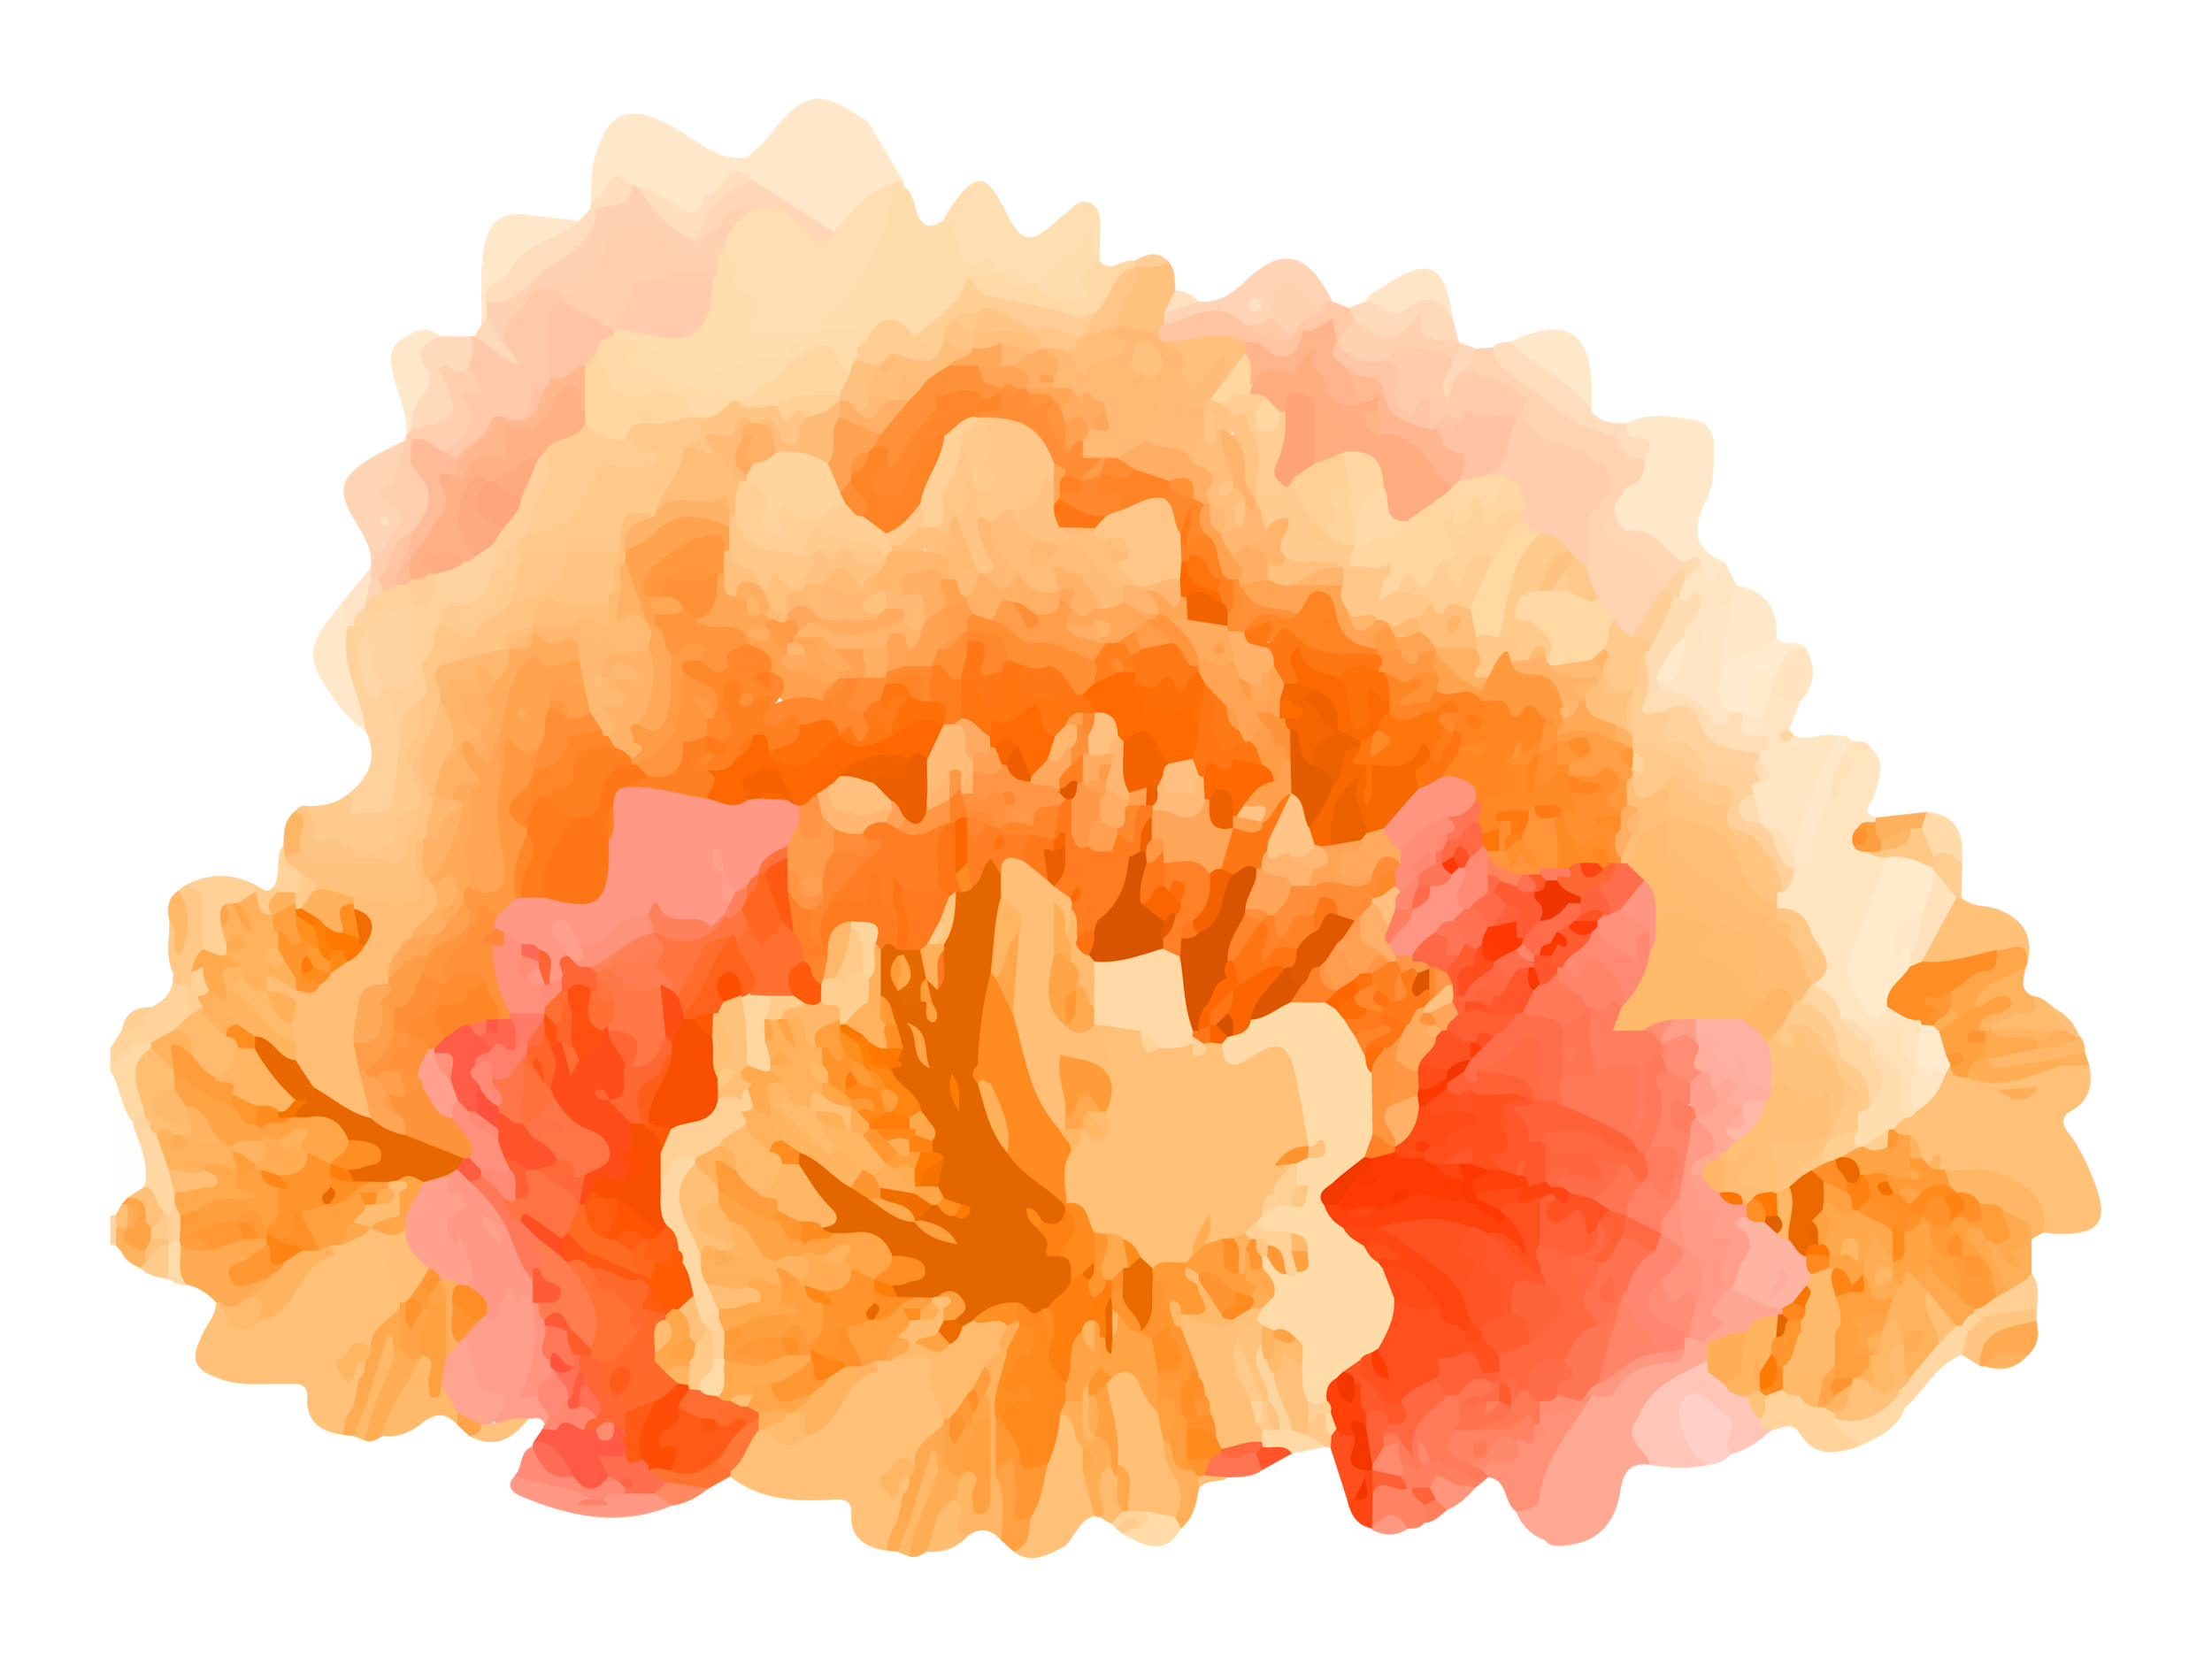
WHAT IS THIS TOPIC ABOUT?
Here you could give a brief description of the matter you want to talk about. For example, if you want to talk about Mercury, you could say that it’s the closest planet to the Sun and the smallest one in the Solar System. It’s only a bit larger than our Moon, and its name has nothing to do with the liquid metal, since it was named after the Roman messenger god, Mercury

Slide 6
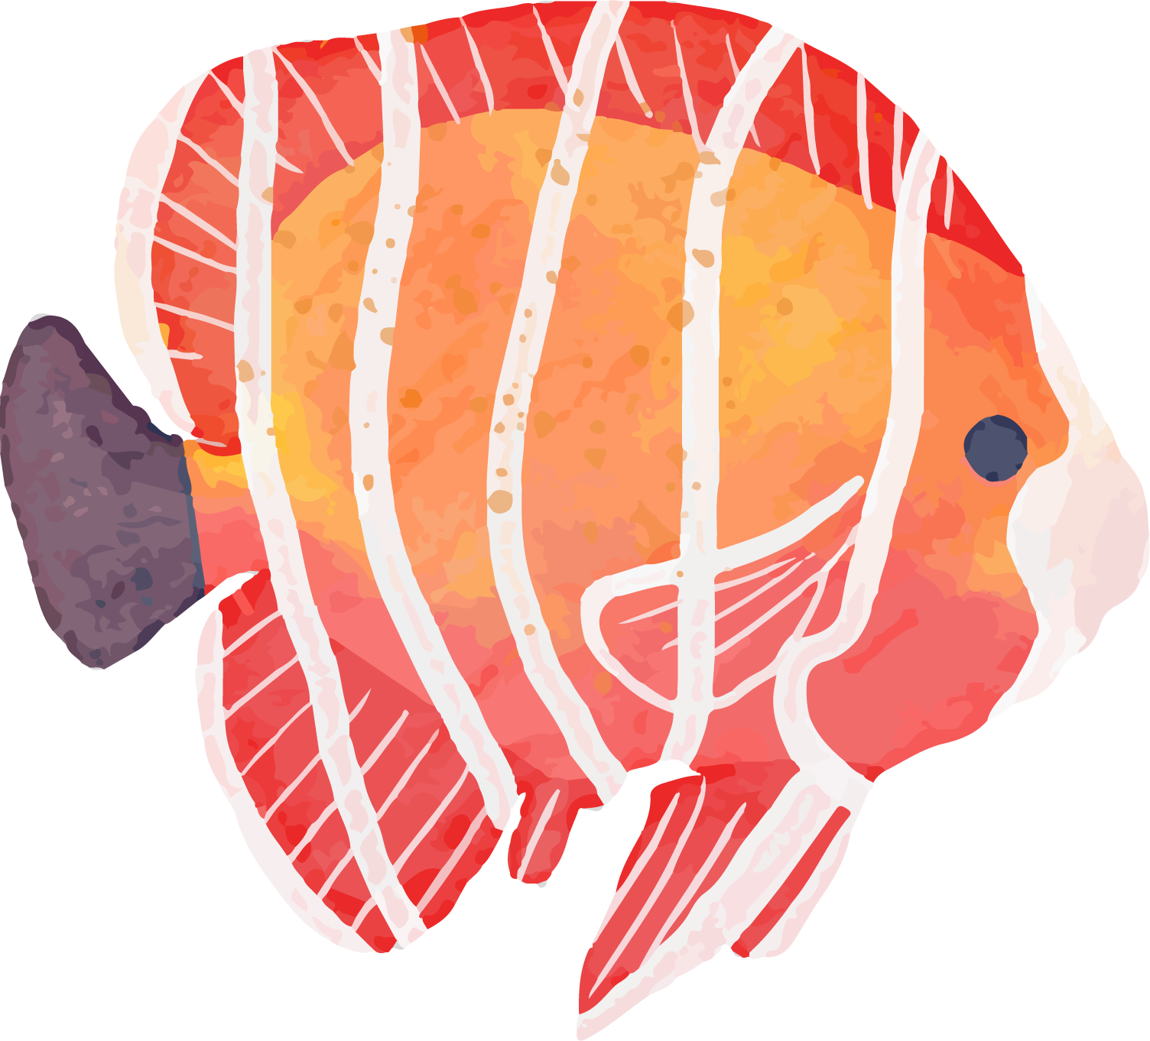
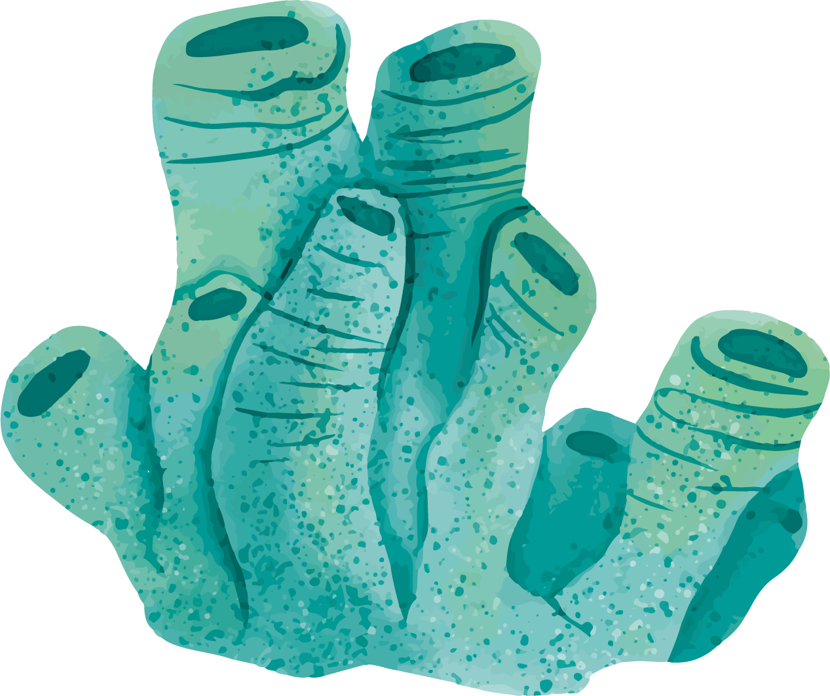
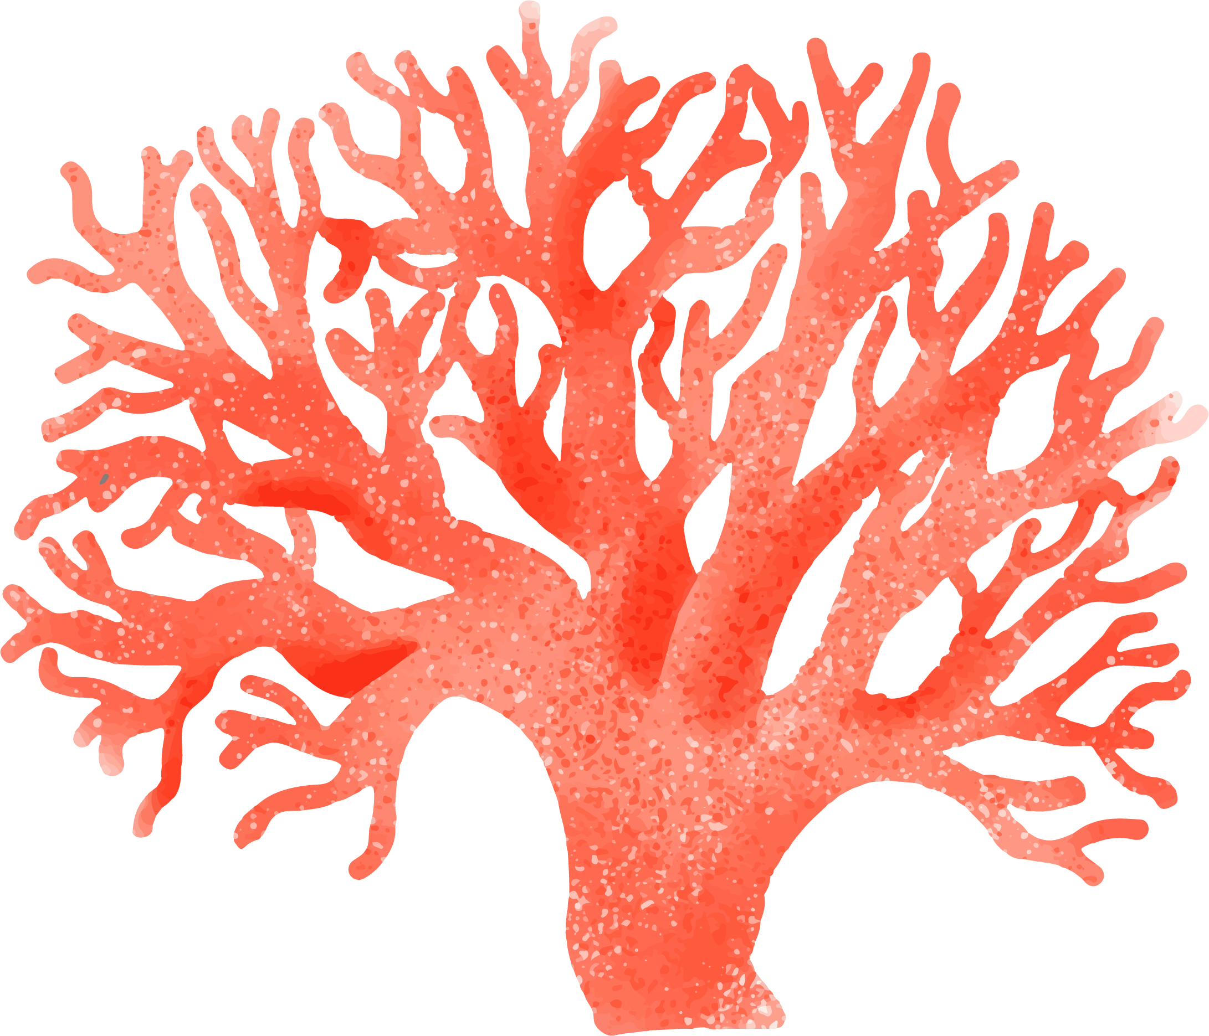
DEFINITION OF CONCEPTS
MERCURY
MARS
SATURN
VENUS
Mercury is the closest planet to the Sun and the smallest one in our Solar System
Despite being red, Mars is a cold place, not hot. It’s full of iron oxide dust
Yes, this is the ringed one. It’s a gas giant, composed mostly of hydrogen and helium
Venus has a beautiful name and is the second planet from the Sun

Slide 7
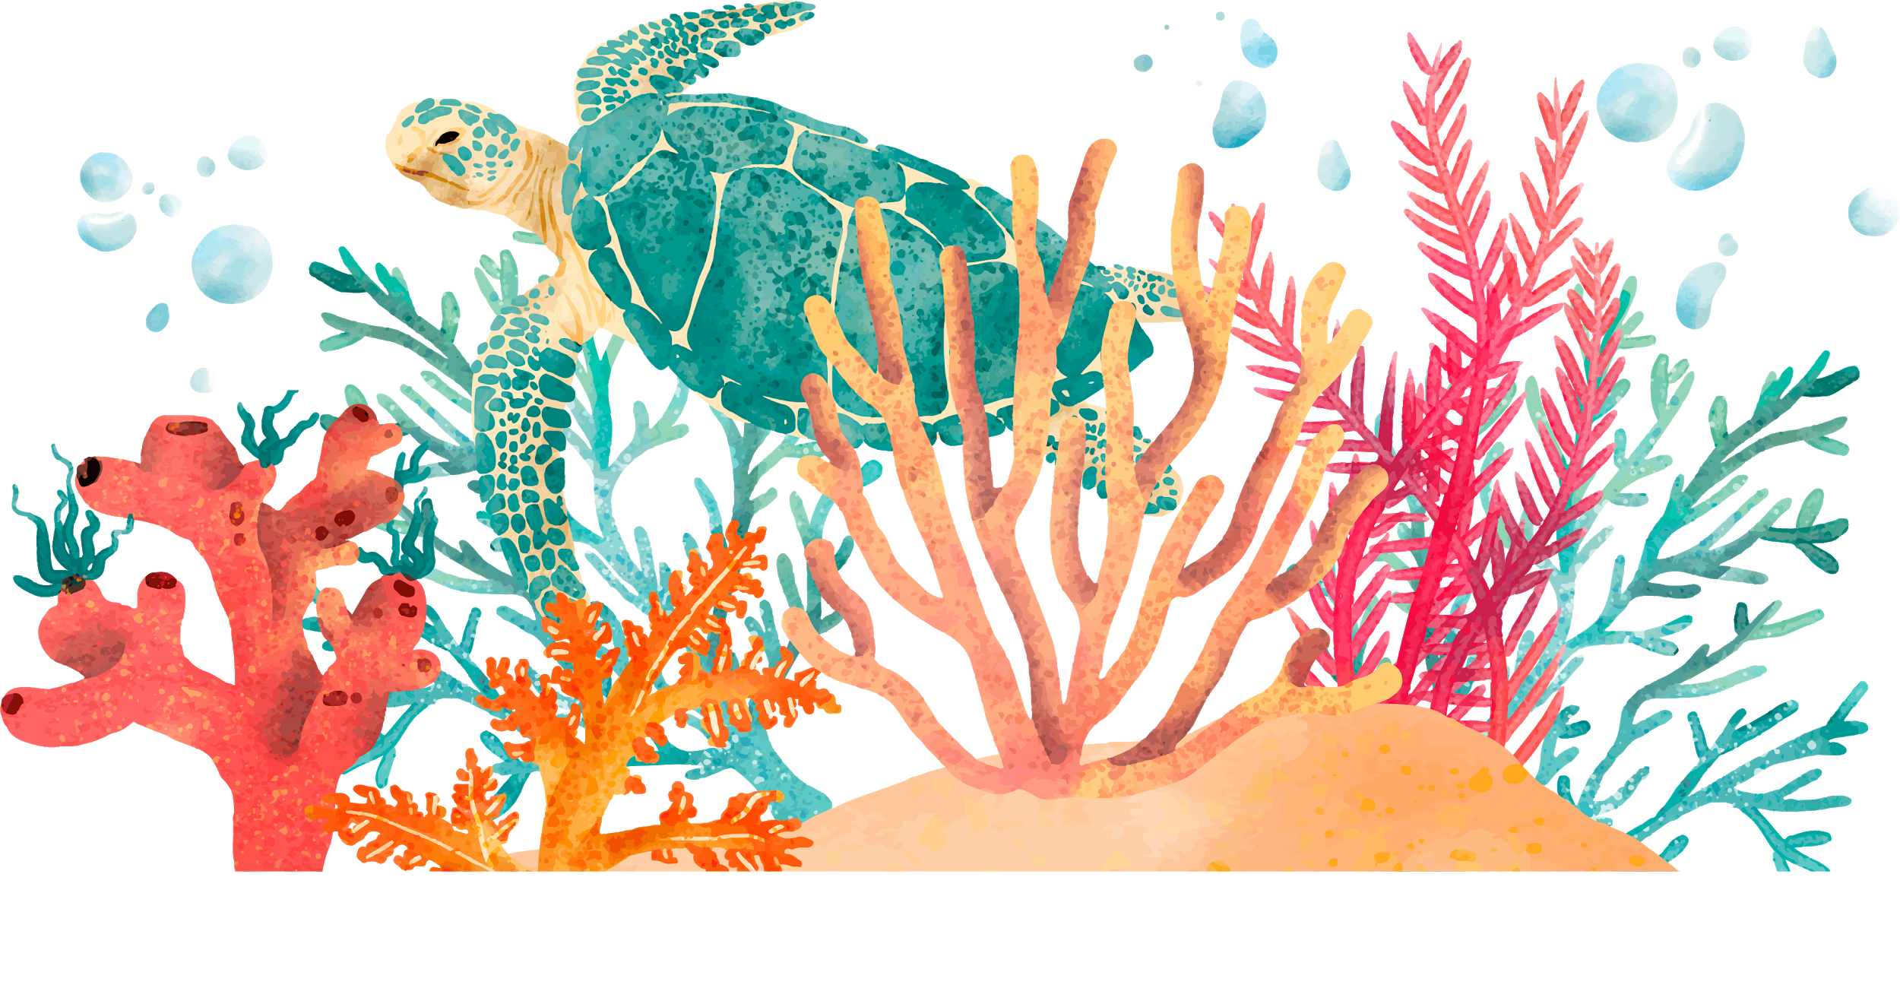
FEATURES OF THE TOPIC
Mercury is the closest planet to the Sun
Despite being red, Mars is a cold place, not hot
Venus has a beautiful name, but it’s terribly hot

Slide 8
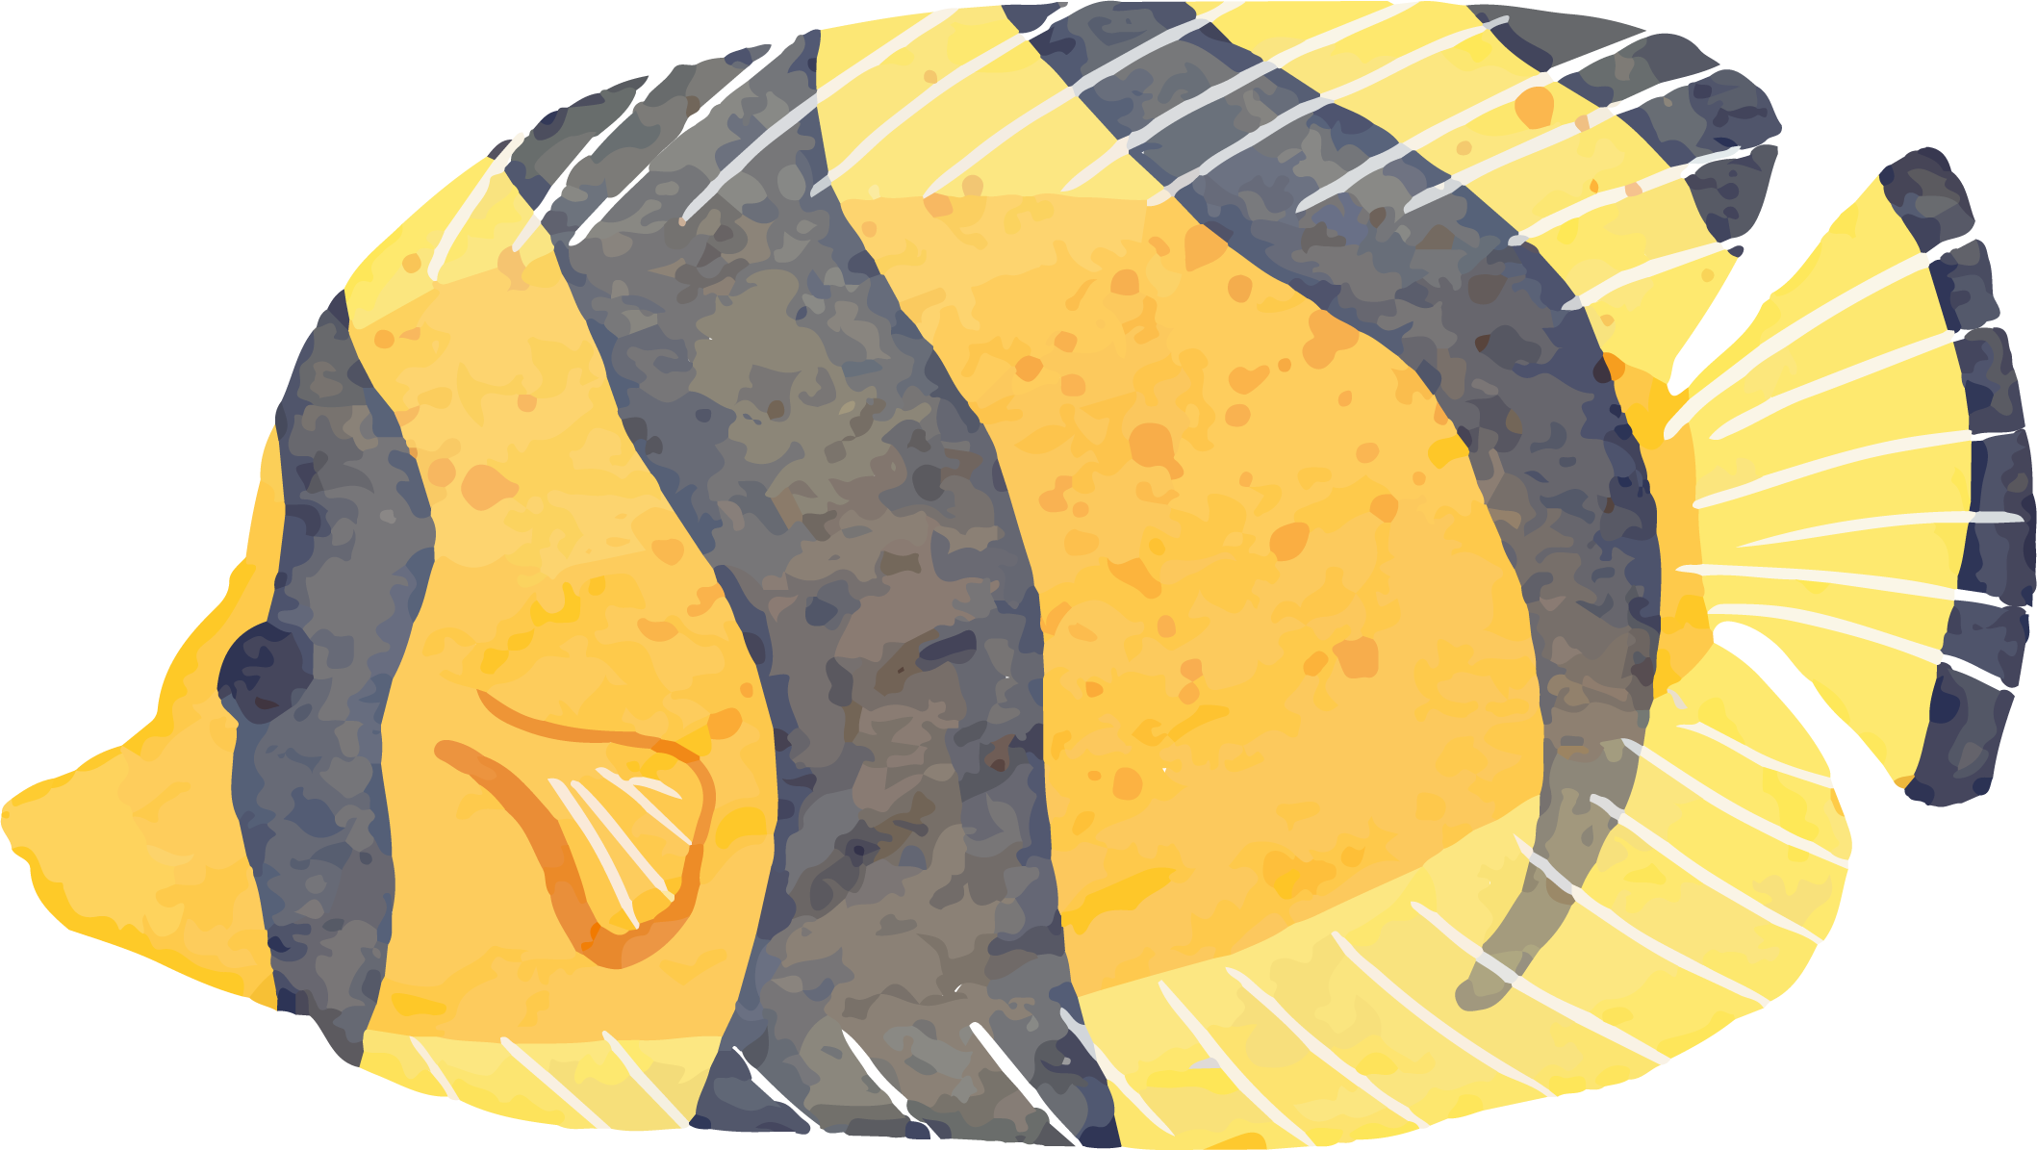
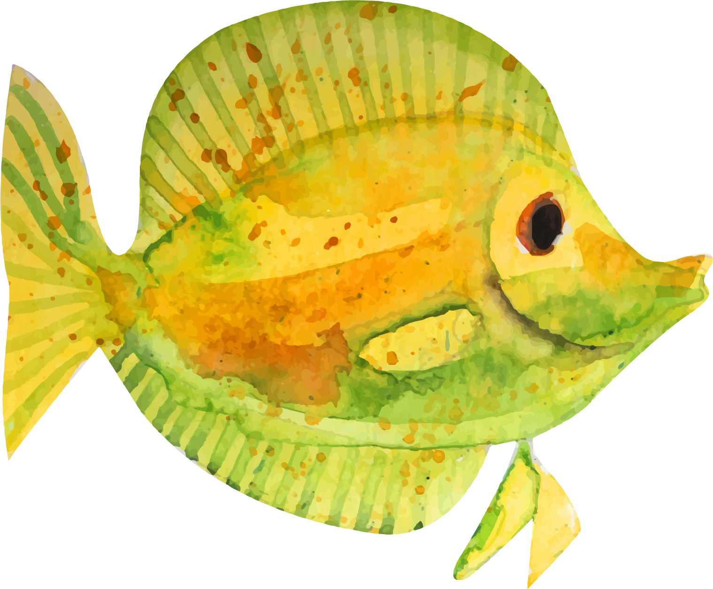
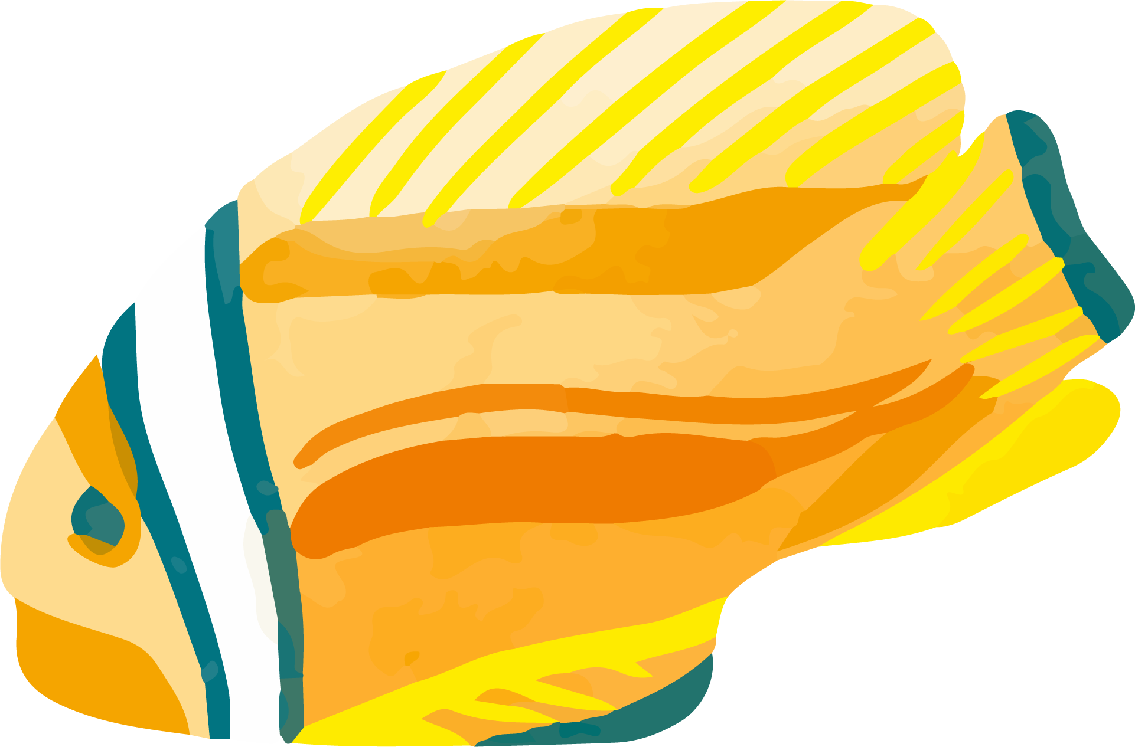
70%
344,000 km²
33,000
of Earth’s surface is water-covered
is the area covered by the Great Barrier Reef
different species of fish have been described so far

Slide 9
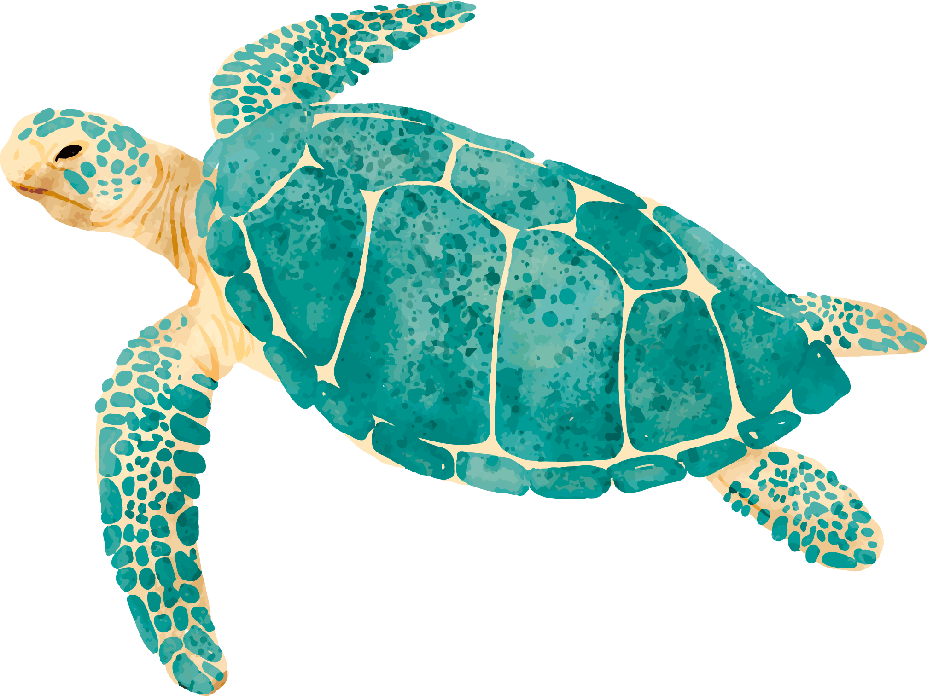
PRACTICAL USES OF THIS SUBJECT
MERCURY
JUPITER
VENUS
Mercury is the closest planet to the Sun and the smallest one in the Solar System. It’s only a bit larger than our Moon
It’s the biggest planet in our Solar System and also the fourth-brightest object in the night sky
Venus has a beautiful name and is the second planet from the Sun. It’s terribly hot, even hotter than Mercury

Slide 10
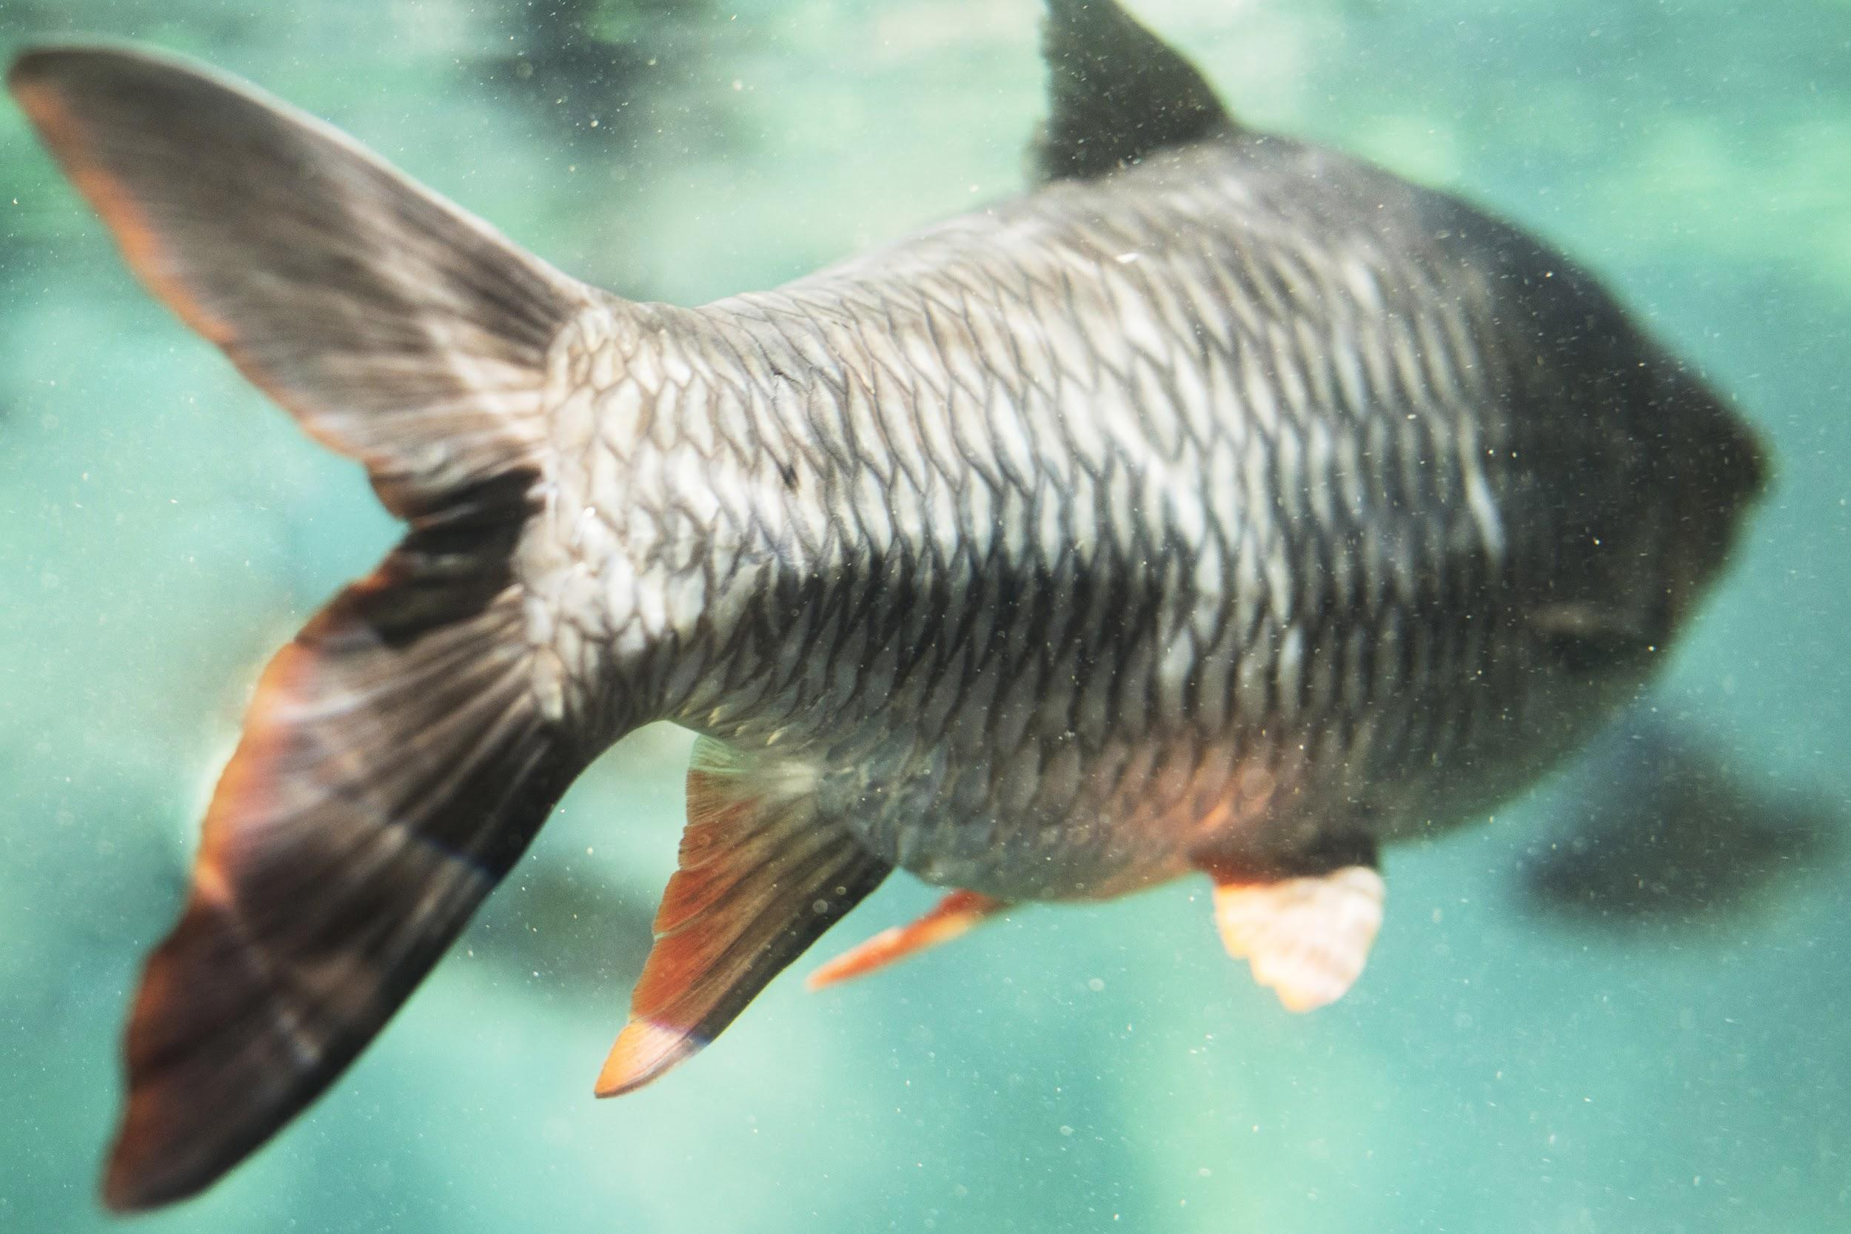
CASE STUDY
Despite being red, Mars is a cold place, not hot. It’s full of iron oxide dust, which gives the planet its reddish cast
Insert your multimedia content here

Slide 11
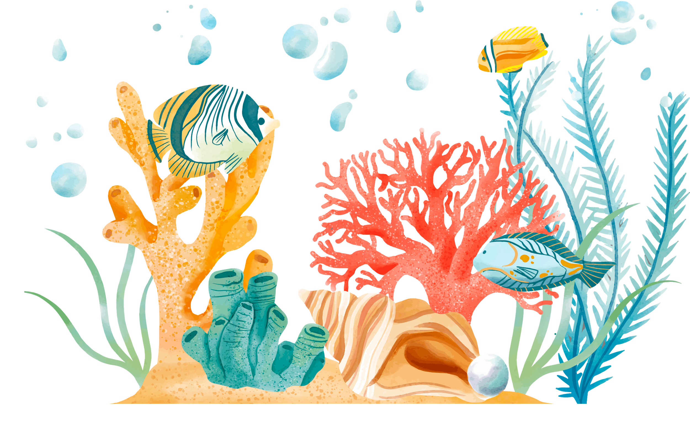
DID YOU KNOW THIS?
Mercury is the closest planet to the Sun and the smallest one in the Solar System
Despite being red, Mars is a cold place, not hot. It’s full of iron oxide dust
Venus has a beautiful name, but it’s terribly hot, even hotter than Mercury

Slide 12
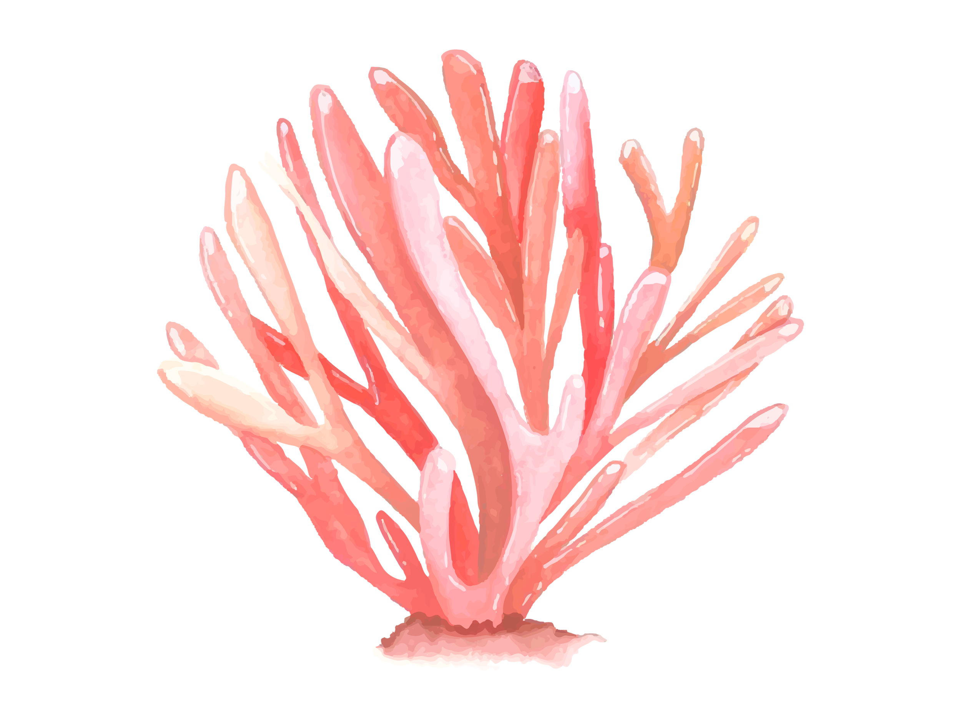
PROBLEM VS. SOLUTION
PROBLEM
SOLUTION
Venus has a beautiful name and is the second planet from the Sun
Despite being red, Mars is a cold place, not hot. It’s full of iron oxide dust

Slide 13
PROCESS
STEP 2
STEP 3
Mercury is the closest planet to the Sun
Venus has a beautiful name, but it’s terribly hot
STEP 1
STEP 4
Saturn is the ringed one. It’s a gas giant
Despite being red, Mars is a cold place, not hot

Slide 14
OVERVIEW DIAGRAM
Mercury is the closest planet to the Sun and the smallest one in the Solar System
Saturn is the ringed one. It’s a gas giant, composed mostly of hydrogen and helium
Jupiter is the biggest planet in our Solar System and also the fourth-brightest object in the sky

Slide 15
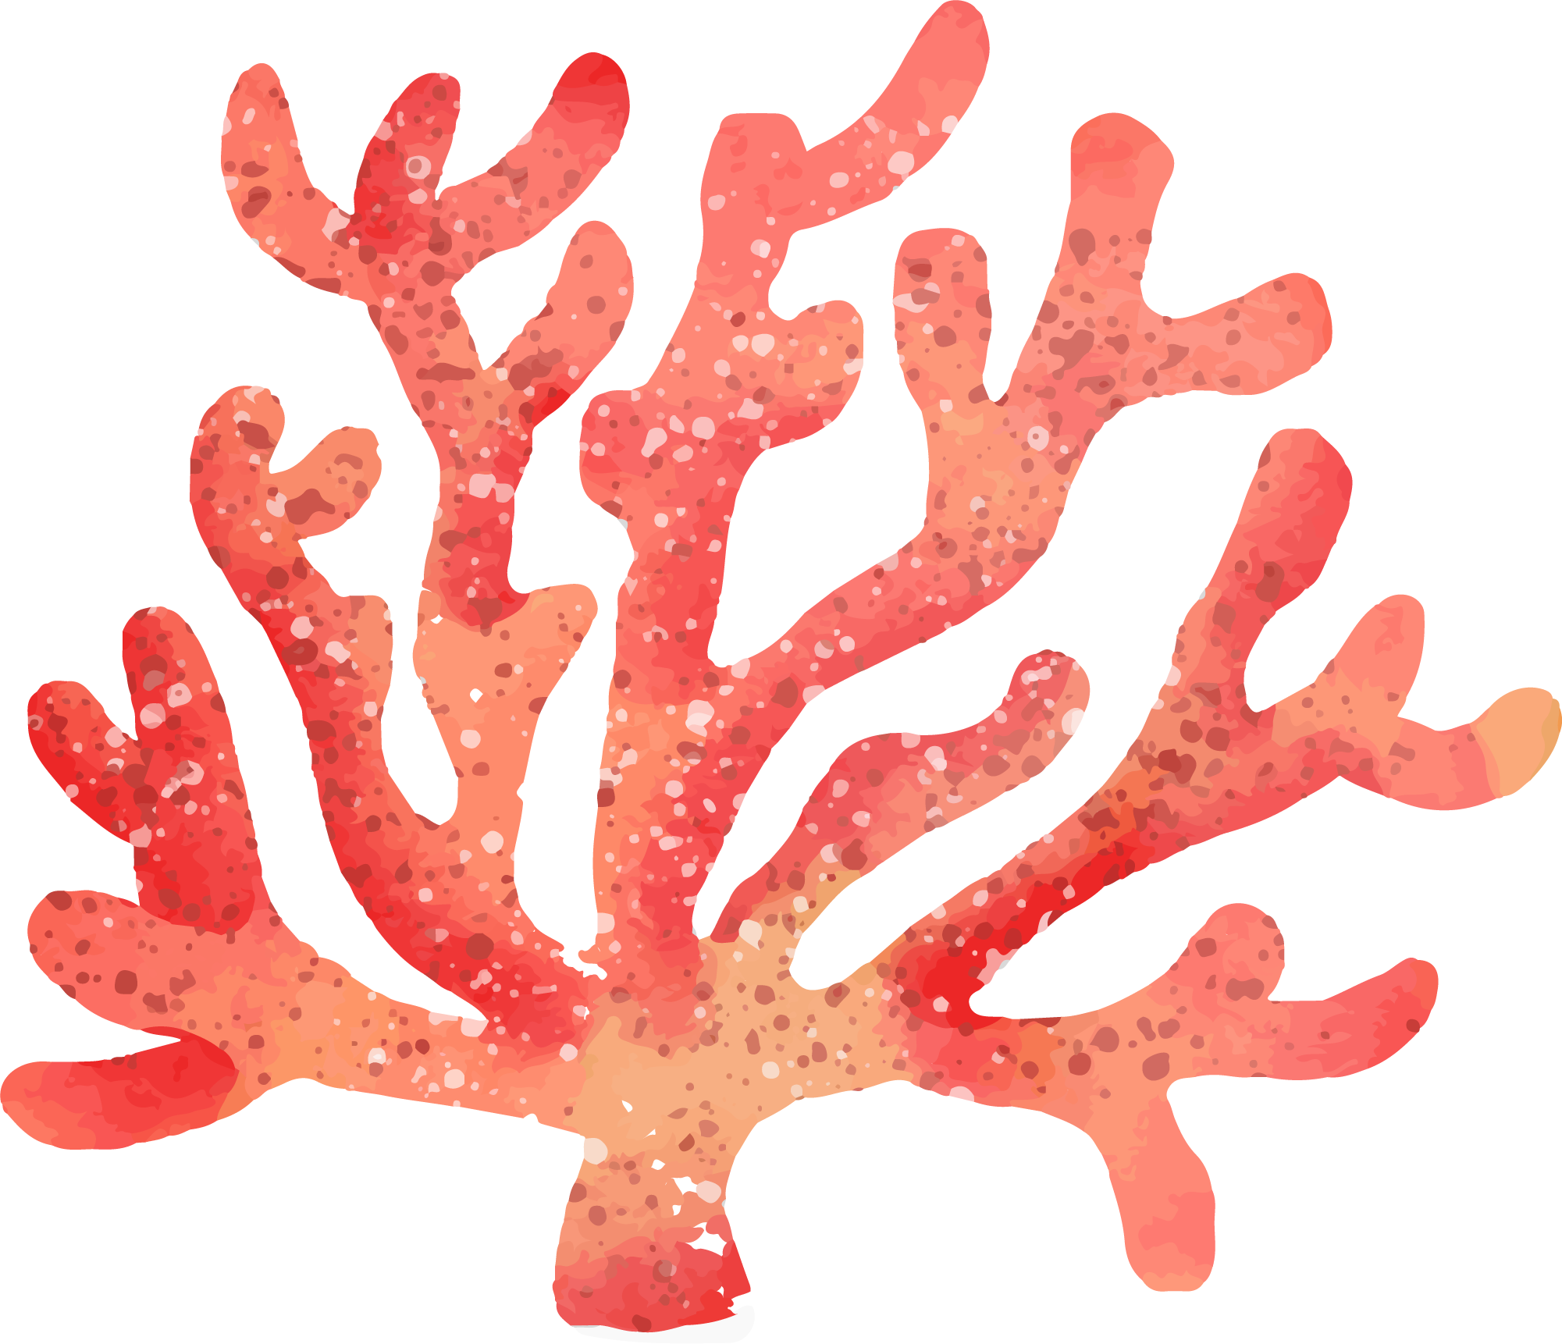
EXERCISE
What is the largest animal found in water?
The blue whale
The colossal squid
The whale shark
Hint: It’s a mammal and can weigh more than 150 tonnes!

Slide 16
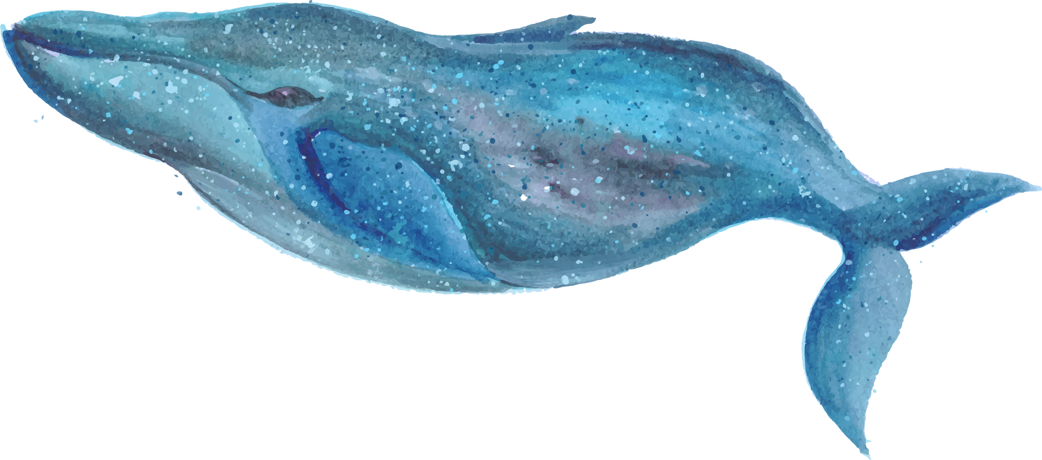
ASSIGNMENT
Which ocean is the deepest in the world?
How big is the blue whale?
What do corals eat and how?

Slide 17
THANKS!
Does anyone have any questions?
addyouremail@freepik.com
+91 620 421 838
yourcompany.com

Slide 18
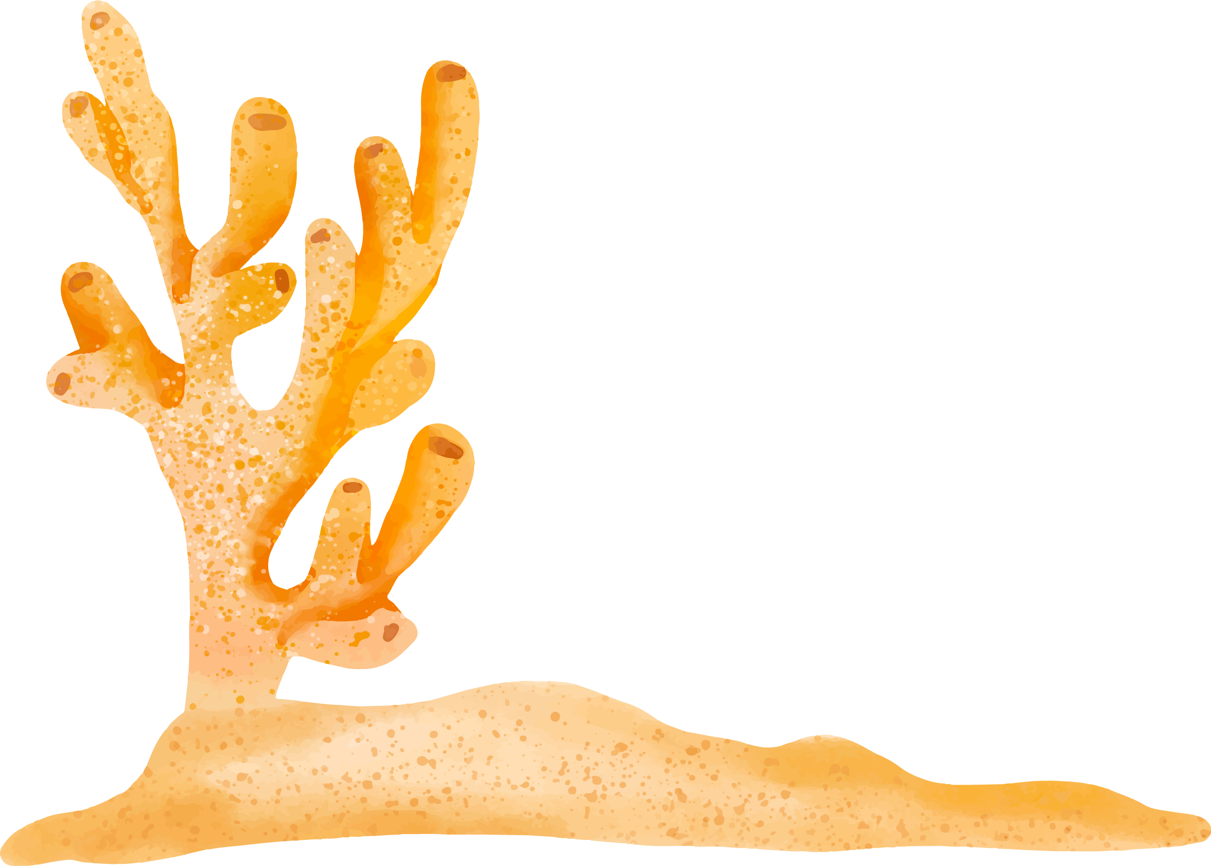
CREDITS
This is where you give credit to the ones who are part of this project.
Did you like the resources on this template? Get them for free at our other websites.
Presentation template by Slidesgo
Icons by Flaticon
Infographics by Freepik
Author introduction slide photo created by Freepik
Text & Image slide photo created by Freepik.com

Slide 19
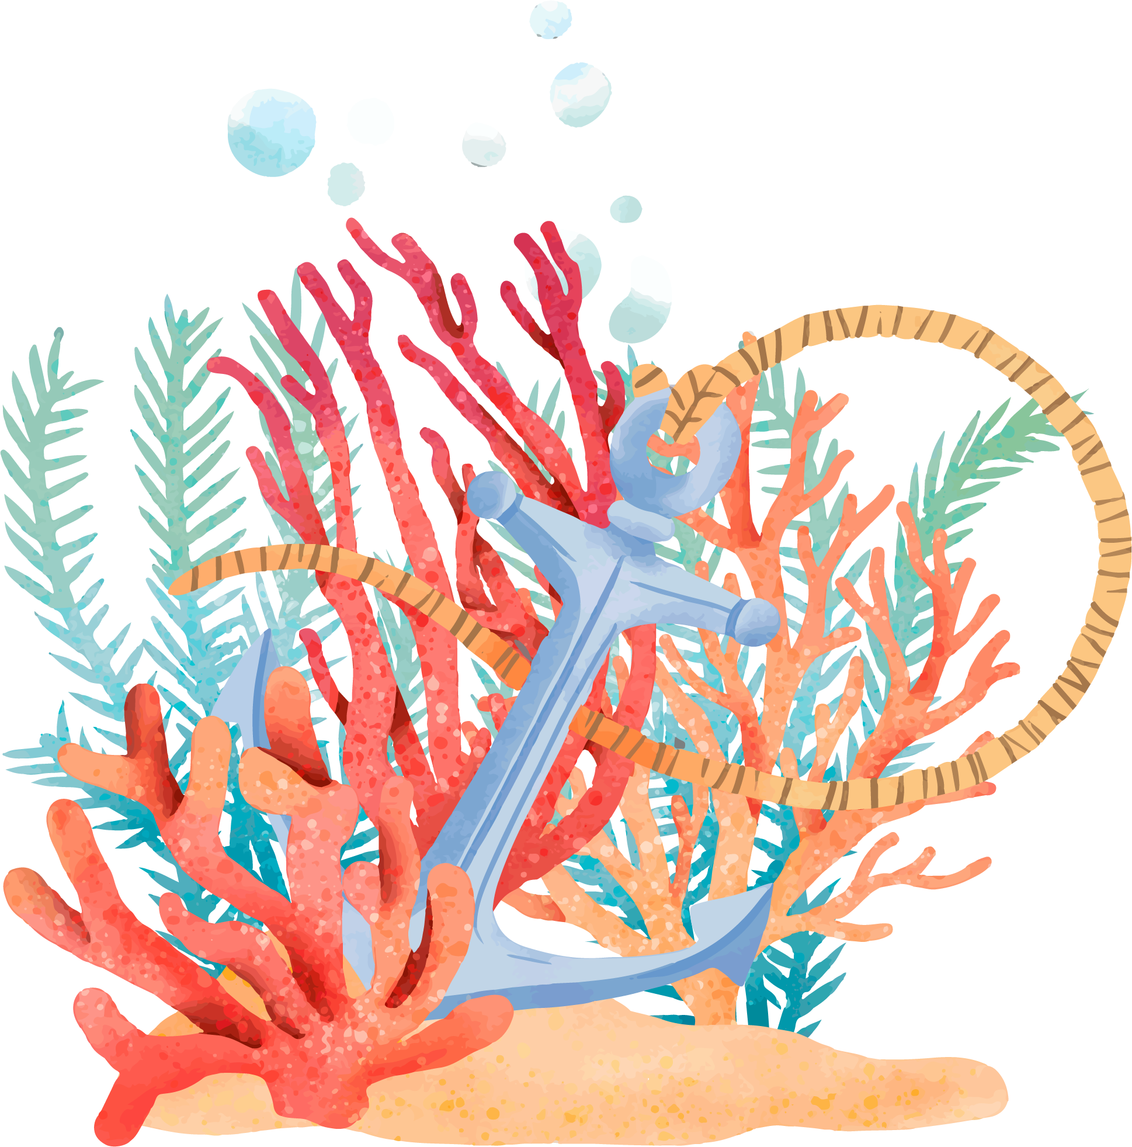
RESOURCES
VECTORS
PHOTOS
Sea life
Waste
Watercolor background with red fish
Pretty watercolor seahorse background
Watercolor seahorses background
Watercolor coral collection
Watercolor coral background
Watercolor coral background template
Watercolor coral background template
Watercolor whale background with message ocean is my friend
Carp

Slide 20
AXLe

