Slide 1
SOLAR SYSTEM LESSON
Here is where the lesson begins

Slide 2
CONTENTS OF THIS TEMPLATE
There’s what you’ll find in this AXLe template made possible by Slidesgo :
A slide structure based on a lesson, which you can easily adapt to your needs. For more info on how to edit the template, please visit axlejm.com
An assortment of illustrations that are suitable for use in the presentation can be found in the alternative resources slide.
A thanks slide, which you must keep so that proper credits for our design are given.
A resources slide, where you’ll find links to all the elements used in the template.
Instructions for use.
Final slides with:
The fonts and colors used in the template.
More infographic resources, whose size and color can be edited.
Sets of customizable icons of the following themes: general, business, avatar, creative process, education, help & support, medical, nature, performing arts, SEO & marketing, and teamwork.
You can delete this slide when you’re done editing the presentation.

Slide 3
TABLE OF CONTENTS
01
02
03
04
OVERVIEW
FEATURES
ASSIGNMENT
ABOUT THE TOPIC
You could give a brief description of the topic here
You could give a brief description of the topic here
You could give a brief description of the topic here
You could give a brief description of the topic here

Slide 4
INTRODUCTION
Venus has a beautiful name and is the second planet from the Sun. It’s terribly hot—even hotter than Mercury—and its atmosphere is very poisonous. It’s the second-brightest natural object in the night sky after the Moon

Slide 5
—SOMEONE FAMOUS
“This is a quote. Words full of wisdom that someone important said and can make the reader get inspired.”

Slide 6
01
OVERVIEW
You could enter a subtitle here if you need it

Slide 7
WHAT IS THis TOPIC ABOUT?
THE SOLAR SYSTEM
Here you could give a brief description of the topic you want to talk about
Here you could give a brief description of the topic you want to talk about
Here you could give a brief description of the topic you want to talk about
Here you could give a brief description of the topic you want to talk about

Slide 8
DEFINITION of CONCEPTS
MERCURY
MARS
SATURN
VENUS
Mercury is the closest planet to the Sun
Despite being red, Mars is actually a cold place
It’s composed mostly of hydrogen and helium
Venus is the second planet from the Sun

Slide 9
FEATURES OF THE TOPIC
MERCURY
JUPITER
VENUS
Mercury is the closest planet to the Sun and the smallest of them all
Jupiter is a gas giant and the biggest planet in the Solar System
Venus has a beautiful
name and is the second
planet from the Sun

Slide 10
98,300
Big numbers catch your audience’s attention

Slide 11
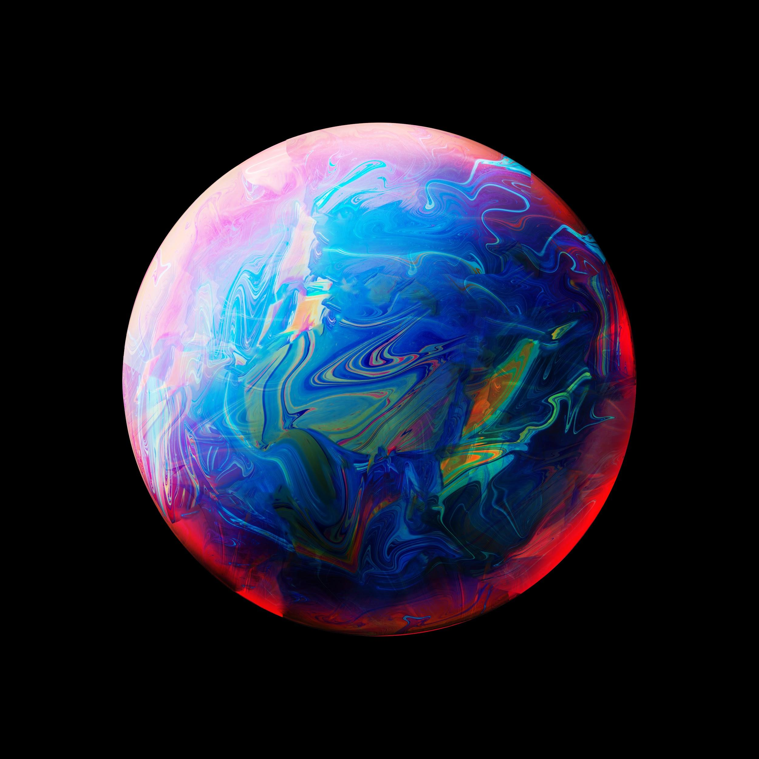
A PICTURE ALWAYS REINFORCES THE CONCEPT
Images reveal large amounts of data, so remember: use an image instead of long texts

Slide 12
42%
33%
25%
Mercury is the closest planet to the Sun and the smallest of them all
Jupiter is a gas giant and the biggest planet in the Solar System
Venus has a beautiful name and is the second planet from the Sun

Slide 13
PRACTICAL USES OF THIS SUBJECT
MERCURY
VENUS
MARS
JUPITER
SATURN
NEPTUNE
Mercury is the closest planet to the Sun
Venus is the second planet from the Sun
Despite being red, Mars is actually a cold place
It’s the biggest planet in the Solar System
Saturn is a gas giant and has several rings
Neptune is the farthest planet from the Sun

Slide 14
CONTENTS OF THIS SUBJECT
 | LESSON 1 | LESSON 2 | LESSON 3
MONTH 1 | Mercury is the closest planet to the Sun | Venus is the second planet from the Sun | Despite being red, Mars is a cold place
MONTH 2 | Jupiter is the biggest planet of them all | Saturn a gas giant and has several rings | Earth is the planet where we live on

Slide 15
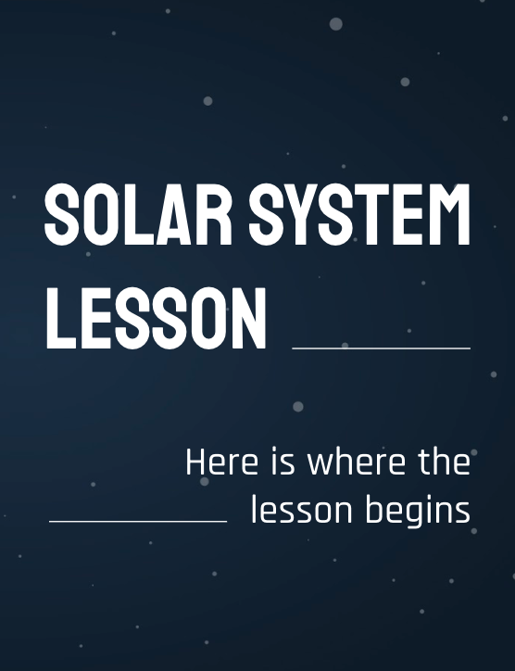
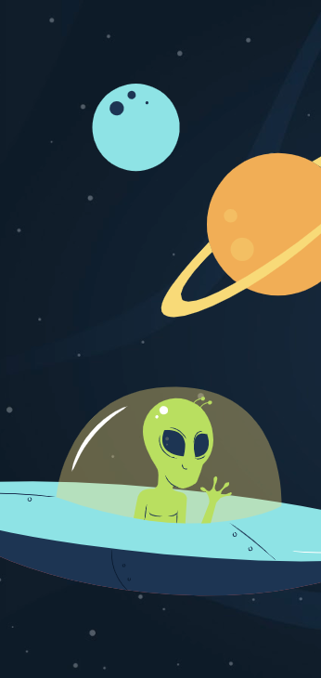
INSERT YOUR MULTIMEDIA CONTENT HERE
Despite being red, Mars
is actually a cold place.
It’s full of iron oxide dust, which gives the planet its reddish cast

Slide 16
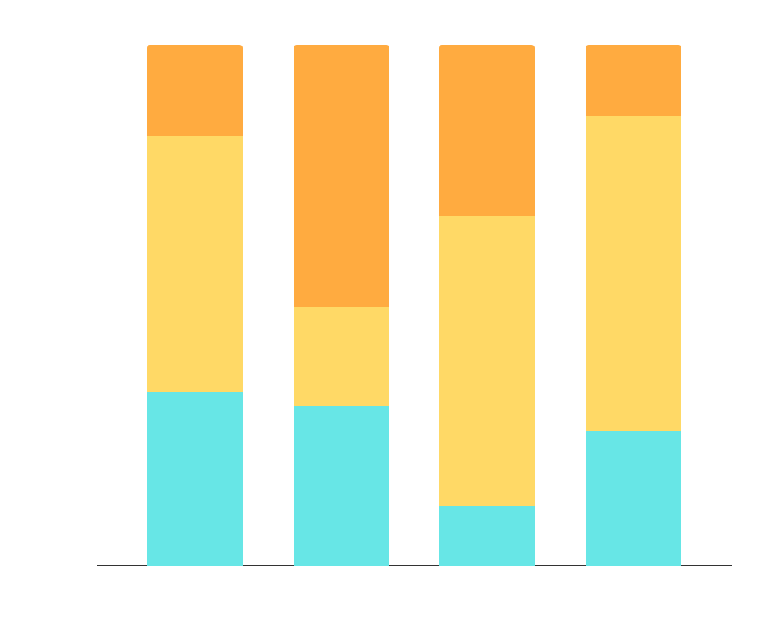
DID YOU KNOW THIS?
42%
23%
Factor 1
Factor 2
Factor 3
Mercury is the smallest planet
Venus has a beautiful name
To modify this graph, click on it, follow the link, change the data and paste the new graph here

Slide 17
PROBLEM VS. SOLUTION
PROBLEM
SOLUTION
Venus has a beautiful
name and is the second
planet from the Sun. Its atmosphere is very poisonous
Despite being red, Mars
is actually a cold place.
It’s full of iron oxide. Which gives the planet its reddish cast

Slide 18
A PICTURE IS WORTH A THOUSAND WORDS

Slide 19
STUDIES AROUND THE WORLD
MERCURY
VENUS
Mars
Mercury is the smallest planet
Venus has a beautiful name
Despite being red, Mars is cold

Slide 20
PROCESS
MERCURY
SATURN
Mars
VENUS
Mercury is the smallest planet
Saturn is the ringed one
Despite being red, it’s cold
Venus has a beautiful name

Slide 21
OVERVIEW DIAGRAM
1
Jupiter is the biggest planet
Planets
2
Venus has a beautiful name
SOLAR SYSTEM
3
Europa is the sixth-largest moon
MOONS
4
Ganymede is the most massive

Slide 22
EXERCISE
Mercury is the closest planet to the Sun, but does its name have anything to do with the liquid metal?
Contrary to popular belief, it doesn’t. The truth is that this planet was named after the Roman messenger god

Slide 23
ASSIGNMENT
Complete the name of the missing planets and calculate their respective orbital speeds:

Slide 24
THANKS!
Do you have any questions? youremail@freepik.com
+91 620 421 838
yourcompany.com
Please keep this slide for attribution.

Slide 25
ALTERNATIVE ICONS

Slide 26
ALTERNATIVE RESOURCES

Slide 27
RESOURCES
Did you like the resources on this template? Get them for free on our other websites.
VECTORS:
Modern astronaut character with flat design
Solar system infographic
Lovely galaxy background with flat design
Solar system infographic pack
Outer space concept illustration
Flat design universe infographic concept
Solar system infographic concept
Colorful gradient space with a rocket background
Solar system infographic
PHOTOS:
Blackboard with rocket and pens
Abstract background with blue pink and yellow sphere
ICONS:
Space Icon Pack

Slide 28
AXLe

